Slide 1
1
Lecture 1. INTRODUCTION TO ROBOTICS. GEOMETRY OF THE ROBOT MANIPULATOR
Topics :
1. Manual Production and Mass Production
2. Hard Automation and Flexible Automation
3. Compromises Between Manual Production, Hard Automation and
Flexible Automation
4. Definition of “Robot”
5. Functional Scheme of Robot
6. Parts of the Course “Fundamentals of Robotics”

Slide 2
2
Manual Production and Mass Production
Since the industrial revolution most of products were manufactured by craftsmen. The product quality depended highly on the skill of the craftsmanship and product cost was high. This is known as manual production.
At the beginning of the twentieth century (1905) Ford Motor Company introduced the concept of mass production. In a mass-production most manufacturing processes are carried out automatically by special-purpose machines. This method of production reduces the cost of manufacturing.

Slide 3
3
2. Hard Automation and Flexible Automation
The manufacturing automation is subdivided into the hard automation and flexible automation.
In hard automation each mechanism or machine performs one predetermined task, for example, packaging, sewing, etc.
However, in manufacturing it is necessary to perform several production tasks by one mechanism or machine. Curry out of several production tasks is provided by manipulating robot. Because the robot manipulators are controlled by computer or microprocessors, they can easily be reprogrammed for different production tasks. This type of automation is called a flexible automation.

Slide 4
4
3. Compromises Between Manual Production, Hard Automation and
Flexible Automation
Manual production tends to be slow and makes it difficult to achieve consistent product quality.
Hard automation is faster and more precise than the manual and flexible production methods.
Typically, when the production volume is very low, manual production is more economical.
As the production volume increases, flexible automation becomes more cost-effective.

Slide 5
5
4. Definition of “Robot”
The word "robot" was introduced in 1921 by Czech writer Karel Capek in his satirical drama R.U.R. C ( Rossum's Universal Robots) . In this work, robots are machines that resemble people, but work tirelessly. The word robot originated from the Czech word "robota", meaning work.
The definition used by the Robotics Institute of America: “A robot is a re-programmable multi-functional manipulator designed to move materials, parts, tools or specialized devices, through variable programmed motions for the performance of a variety of tasks”.

Slide 6
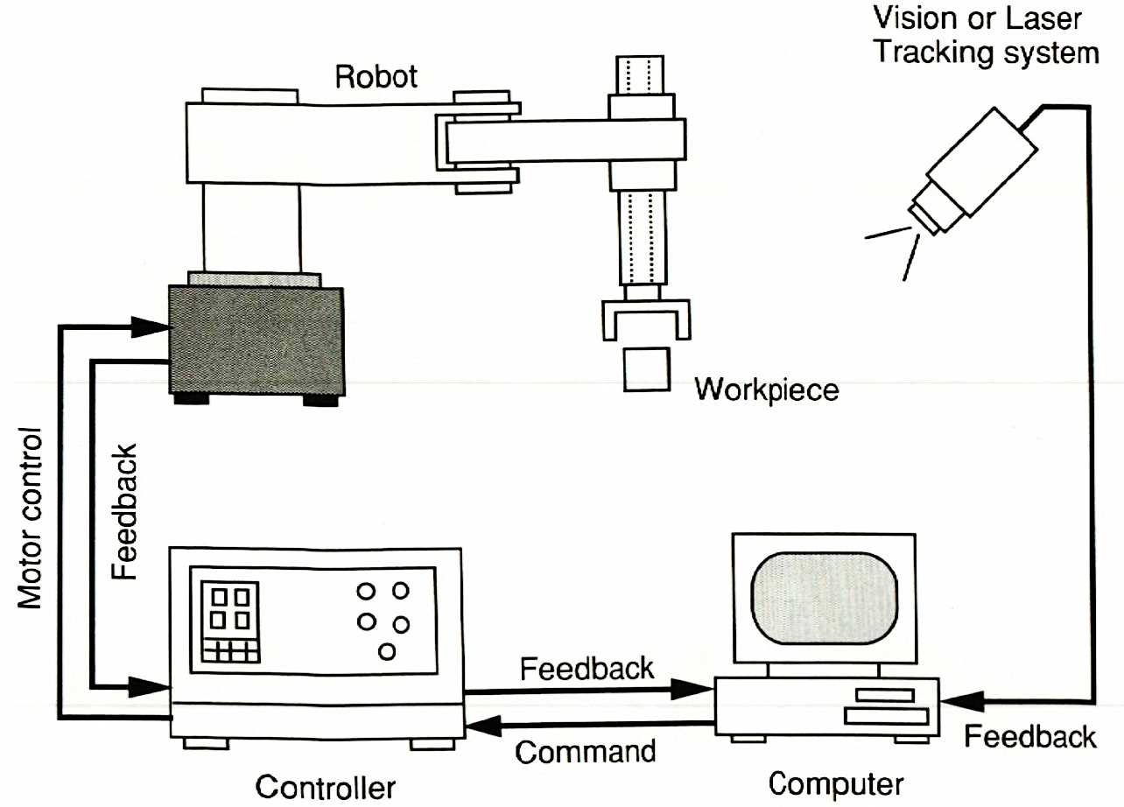
5. Functional Scheme of Robot
Functional scheme of robot consists of a mechanical manipulator, an end-effector, a microprocessor-based controller, a computer, and perhaps, a vision system or other non-contacting devices (Fig.1).
Fig.1.
6

Slide 7
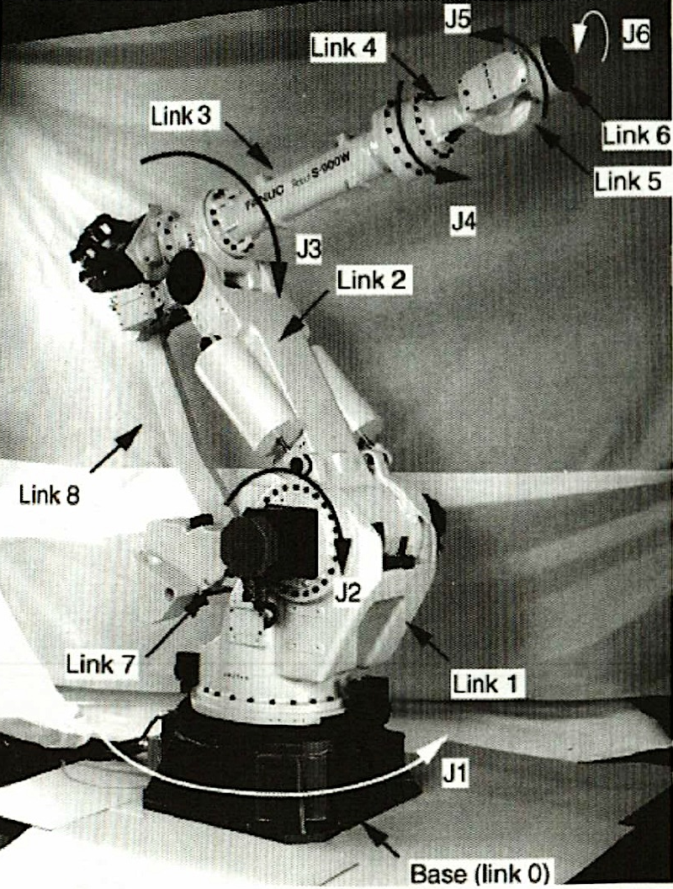
A mechanical manipulator is made up of several links connected by joints (Fig.2).
Fig.2.
The individual bodies that make up a manipulator or mechanism are called the members or links.
Links in a manipulator are connected in pairs. The moving connection between two links is called a kinematic pair or a joint. If one of link rotates with respect to another then this joint is called a revolute joint.
7

Slide 8
The joints in the manipulator can be actuated joints and passive joints. Typically, the number of actuated joints is equal to the number of degrees of freedom (DOF) so that the manipulator can be controlled at will.
Fig.2.
The manipulator shown in Fig.2 is a 6-DOF manipulator in which link 0 is fixed to the ground and link 6 is the output link. The joints between links (0 and 1), (1 and 2), (1 and 7), (3 and 4), (4 and 5) and (5 and 6) are actuated; the others are passive.
8

Slide 9
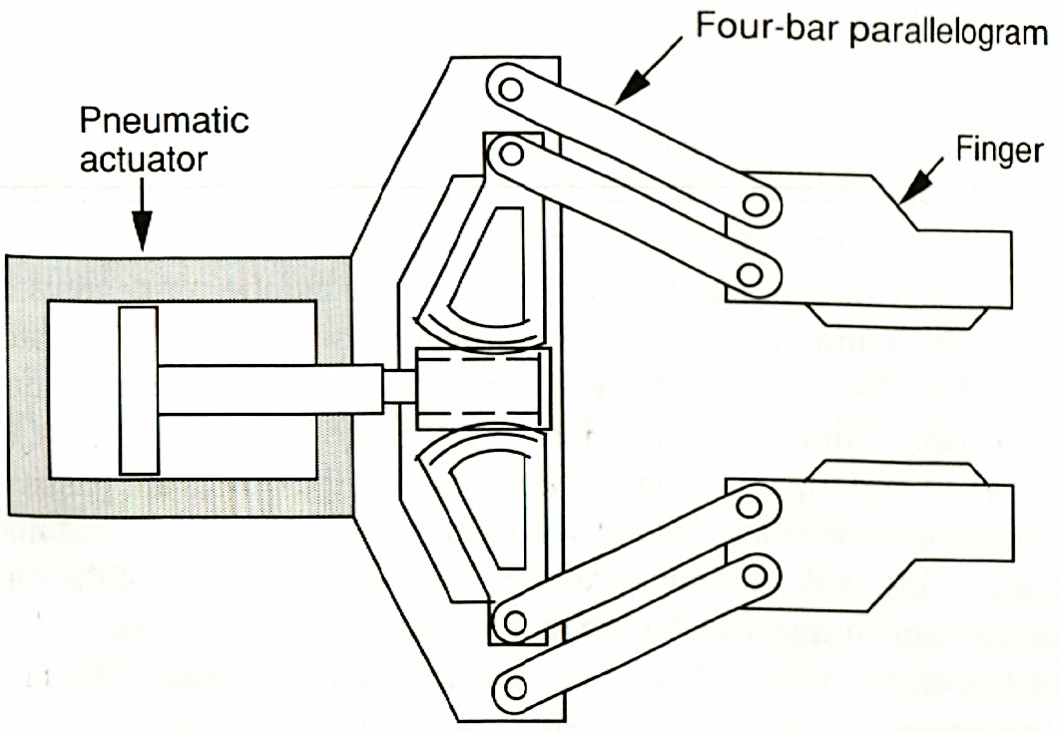
End-effectors are devices attached at the output link of a manipulator to grasp, lift and manipulate work pieces.
Generally, an end-effector is a specialized device that is used for handling of manipulating objects.
Such an end-effector is sometimes is called a gripper. Most simple grippers are 1-DOF devices. Fig.1.3 shows a rack- and –pinion gripper driven by a pneumatic source.
Fig.3.
9

Slide 10
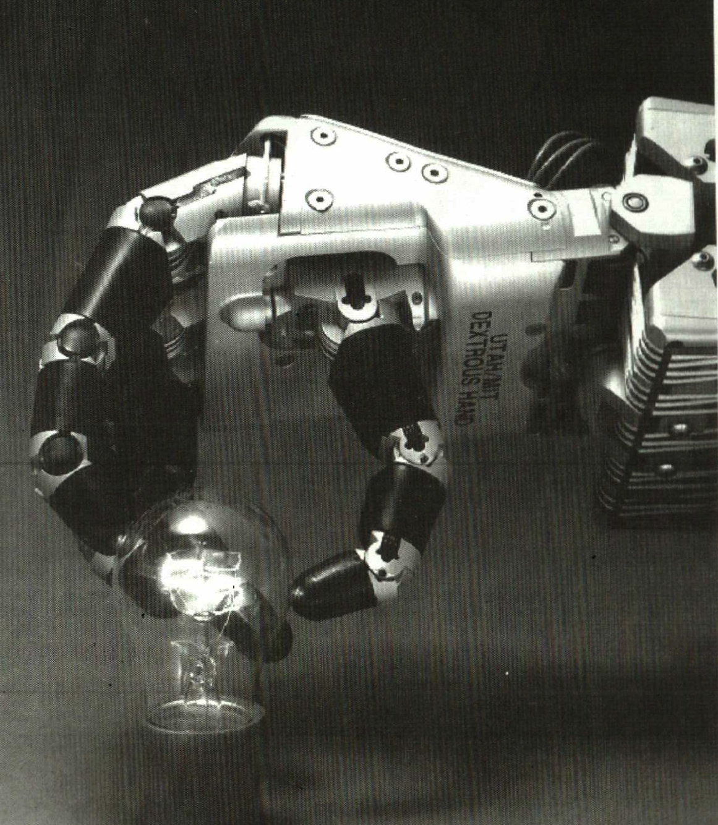
10
For some applications, an end-effector may be required to handle a variety of objects of different shapes, sizes and materials.
An end-effector that requires certain dexterity and versatility is called a universal gripper or dexterous hand. Fig.1.4 shows a Utah/MIT hand. It has some sensing elements in addition to mechanical elements.
Fig.4.

Slide 11
11
The controller may range from a simple low-level PID controller to a high-level model-based intelligent controller.
Encoders and/or tachometers are installed at the joints of a manipulator to measure the relative motion between two connected bodies for the purpose of feedback control.
The computer may be microprocessor-based hardware, a personal computer or a mainframe computer capable of high-speed real-time computation, reasoning and issuing intelligent control commands.

Slide 12
12
6. Parts of the Course “Fundamentals of Robotics”
The course “Fundamentals of Robotics” consists the following parts:
Geometry of manipulating robots (MR)
Kinematics of MR
Statics of MR
Dynamics of MR
Control of MR
Geometry of MR deals with the structure of the robot manipulators, determine their links, joints, DOF.
Kinematics of MR deals with the position and Jacobian analysis of the robot manipulators.
Statics deals with the relations of forces that produce equilibrium among the various members of a robot manipulator.
Dynamics of MR studies the laws of motion of the robot manipulators under the action of forces and moments.
Control of MR deals with the control of actuators of the robot manipulators on the base of obtained laws of kinematics and dynamics.

Slide 13
Lecture 2. STRUCTURAL DIAGRAMS, KINEMATIC PAIRS OF
THE ROBOT MANIPULATERS
1
Topics :
1. Structural Diagram of the Robot Manipulators
2. Kinematic Pairs
3. Kinematic Chains
1. Kinematic Structure of the RM
Manipulator is a principal assembly of robot, because exactly a manipulator performs a mechanical motion to release the predetermined task.
Manipulator made up of several links connected by joints.
The individual bodies that make up a manipulator are called the members or links.
A mobile connection between two links is called a kinematic pair or joint.
A graphical representation of the links connections by the kinematic pairs is called a kinematic structure of the manipulator.

Slide 14
For example, a kinematic structure of the Fanuc S-900W robot (Fig. 5 ), consisting of six links and six joints has a view shown in Fig. 6.
Fig. 5
2

Slide 15
3
Fig. 6

Slide 16
4
2. Kinematic Pairs (Joints)
Kinematic pairs are classified by:
- number of constraints of their elements;
type of contact of their elements;
The contact surface of a link is called a pair element.
Let consider the classification of the kinematic pairs by number of constraints of their elements.

Slide 17
5
Free rigid body Т in space has 6 degrees of freedom: 3 translations and 3 rotations along and about the three axes OX, OY, OZ of the absolute system of coordinates OXYZ (Fig. 7)
Fig. 7

Slide 18
6
Number of constraints S imposed to the relative motion of the kinematic pair elements, should be satisfied to the condition
1 ≤ S ≤ 5 (1)
Then number of DOF H of the kinematic pair element in the relative motion is equal
Н = 6 – S. (2)
Consequently, number of DOF of the kinematic pair element also satisfies the condition
1≤ Н ≤ 5. (3)

Slide 19
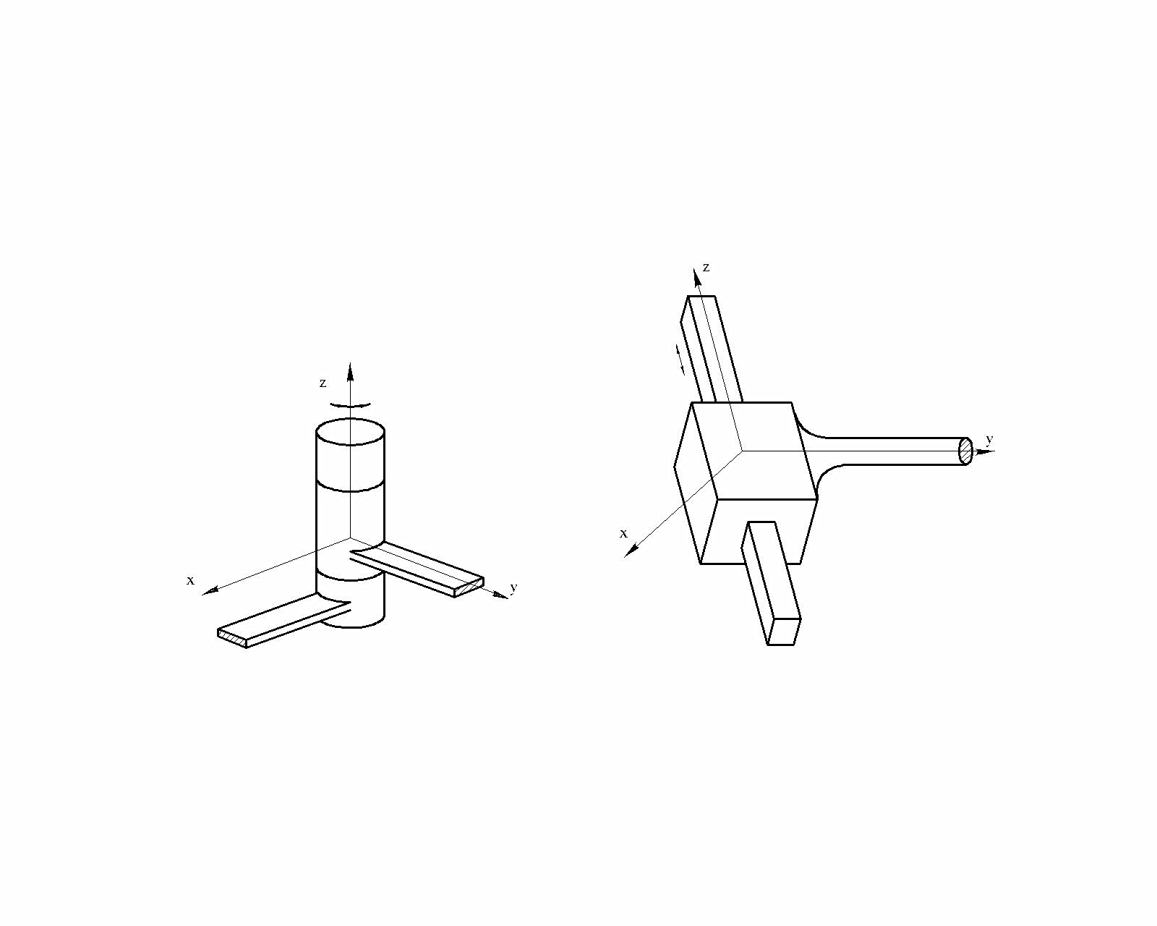
7
Let consider the types of the kinematic pairs. A revolute joint (R) (Fig. 8) permits one relative motion: a rotation about the coordinate axis Z, i.e. H=1 and S=5.
Fig. 8

Slide 20
8
A prismatic joint (P) (Fig. 9) permits one relative motion: a translation or a sliding along the coordinate axis Z, i.e. H=1 and S=5.
Fig. 9

Slide 21
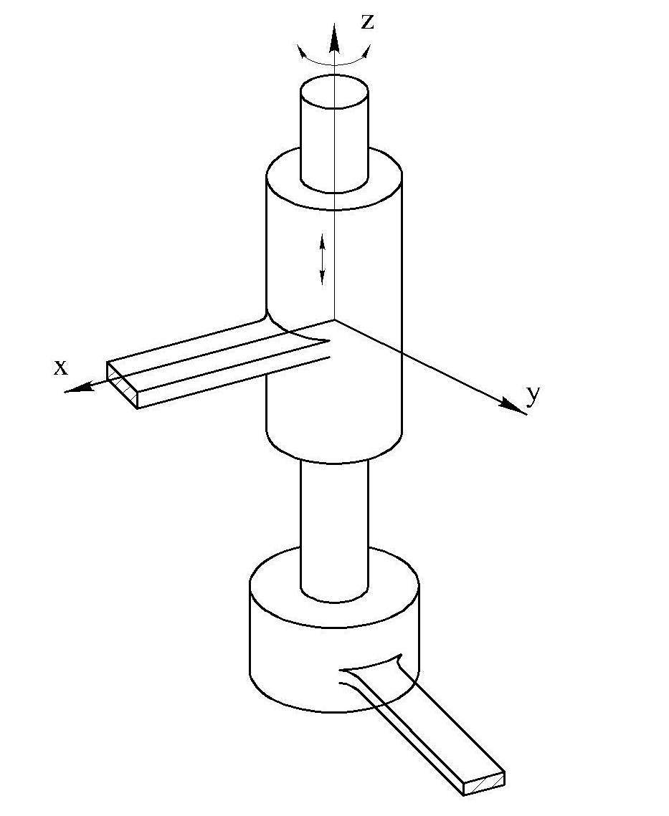
A cylindrical joint (C) (Fig. 10) permits two relative motions: a rotation and a translation about and along the axis Z, i.e. H=2 and S=4.
Fig. 10
9

Slide 22

A helical or screw joint (H) (Fig. 11 ) permits two relative motions: a rotation and a translation about and along the axis Z. However, the translation is related to rotation by the pitch of a screw. Hence one additional constraint is imposed in the helical joint, i.e. H=1 and S=5.
Fig. 11
10

Slide 23
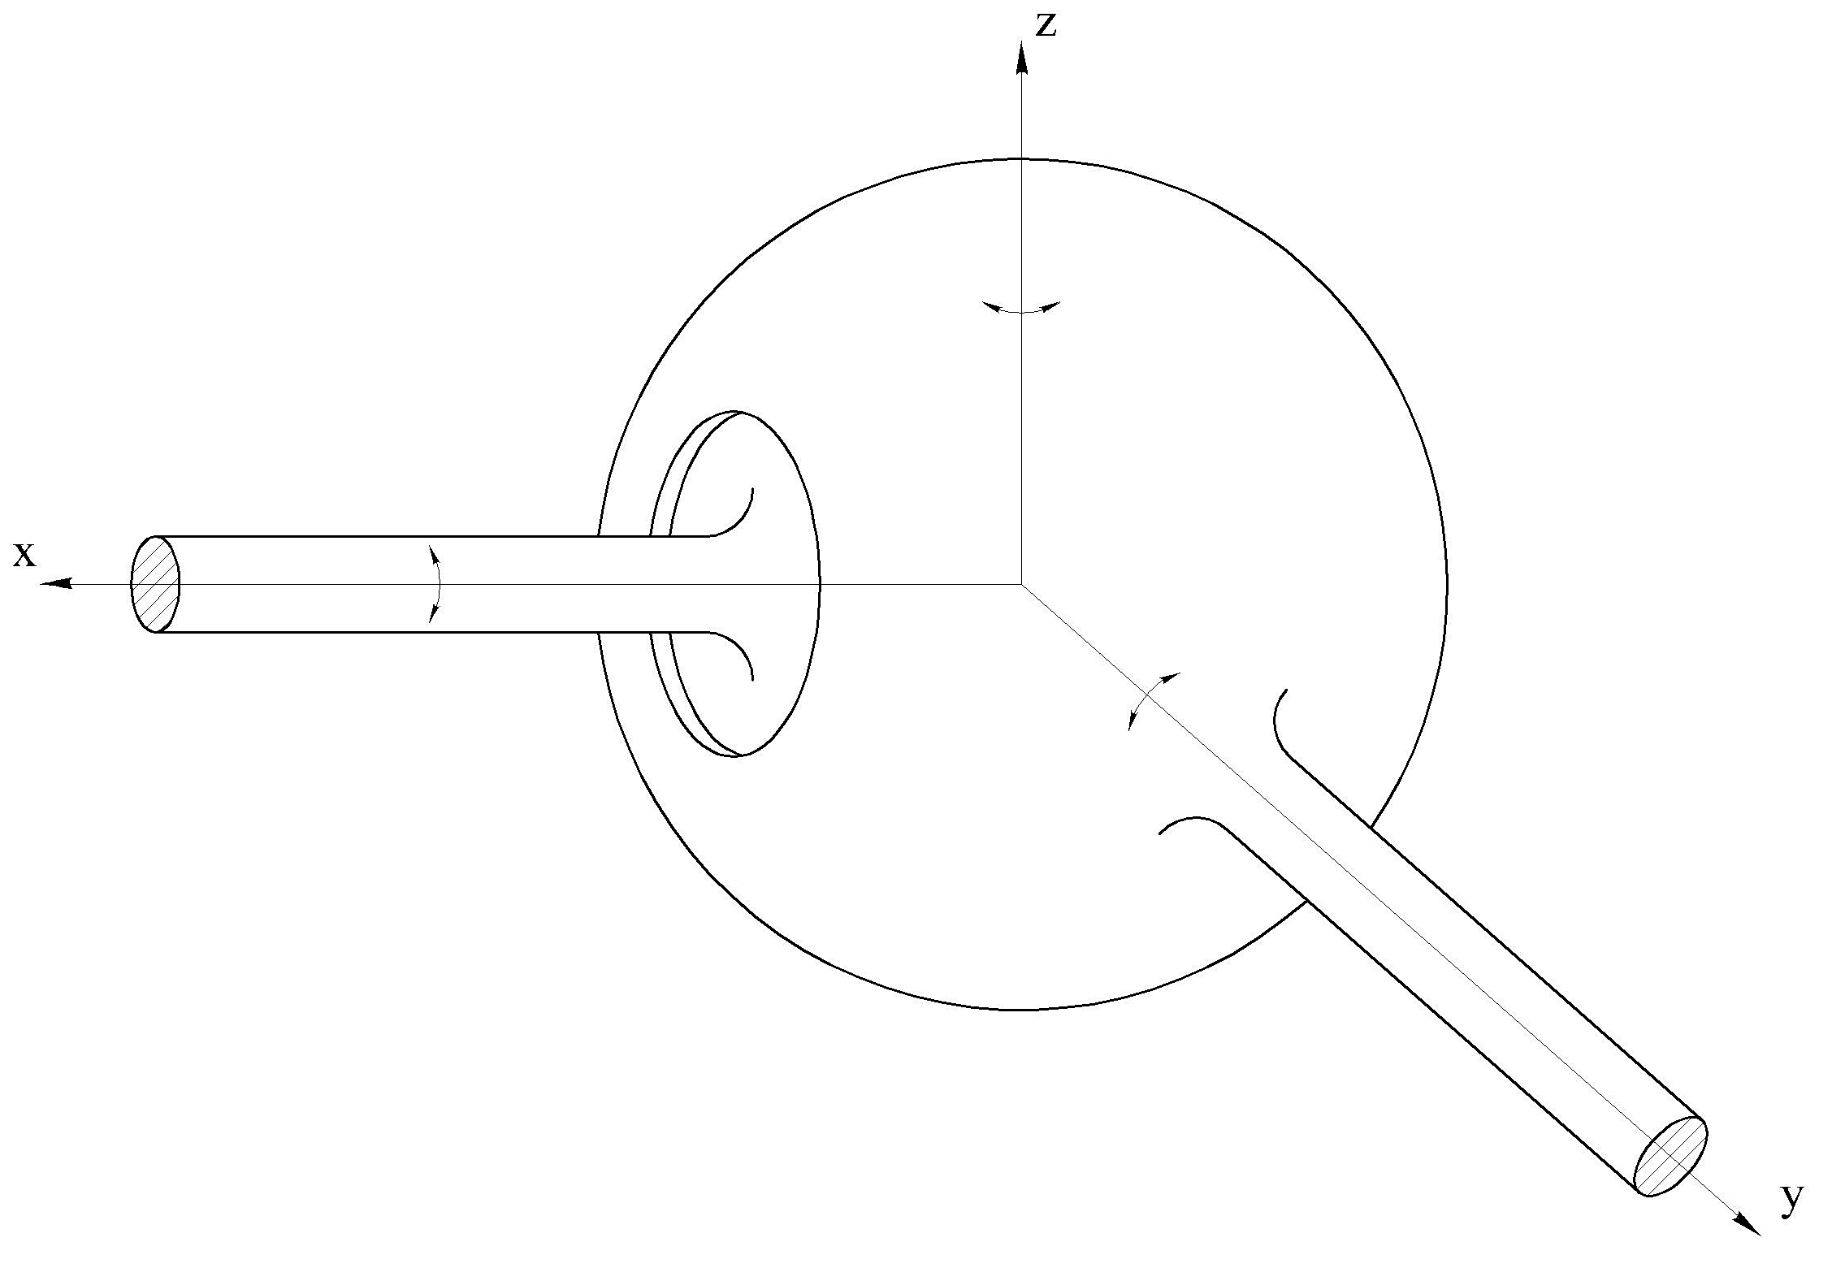
11
A spherical joint (S) (Fig. 12) permits three relative motions: about the axes X, Y, Z, i.e. H=3 and S=3.
Fig. 12

Slide 24
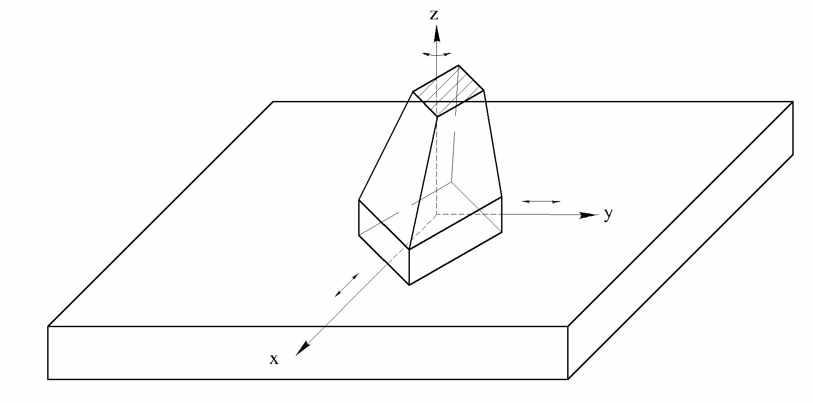
12
A plane kinematic pair (E) (Fig. 13) permits three relative motions: two translations along the axes X, Y and the rotation about the axes Z, i.e. H=3 and S=3.
Fig. 13

Slide 25
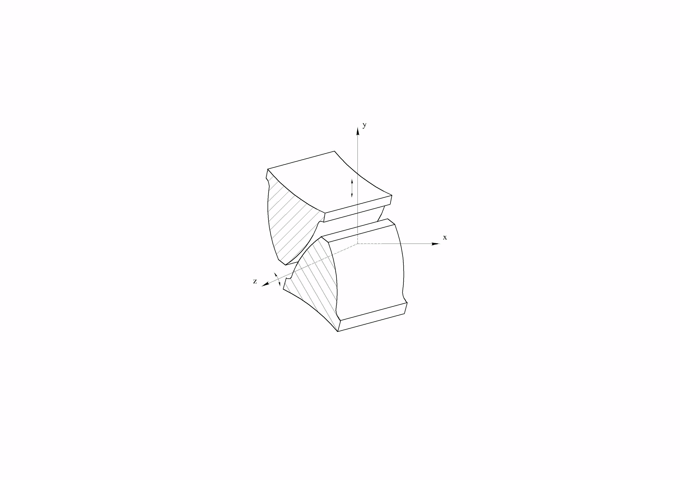
13
A gear kinematic pair (G) (Fig. 14) permits one gear to roll and slide with respect to the other at the point of contact between two meshing teeth, i.e. H=2 and S=4
Fig. 14

Slide 26
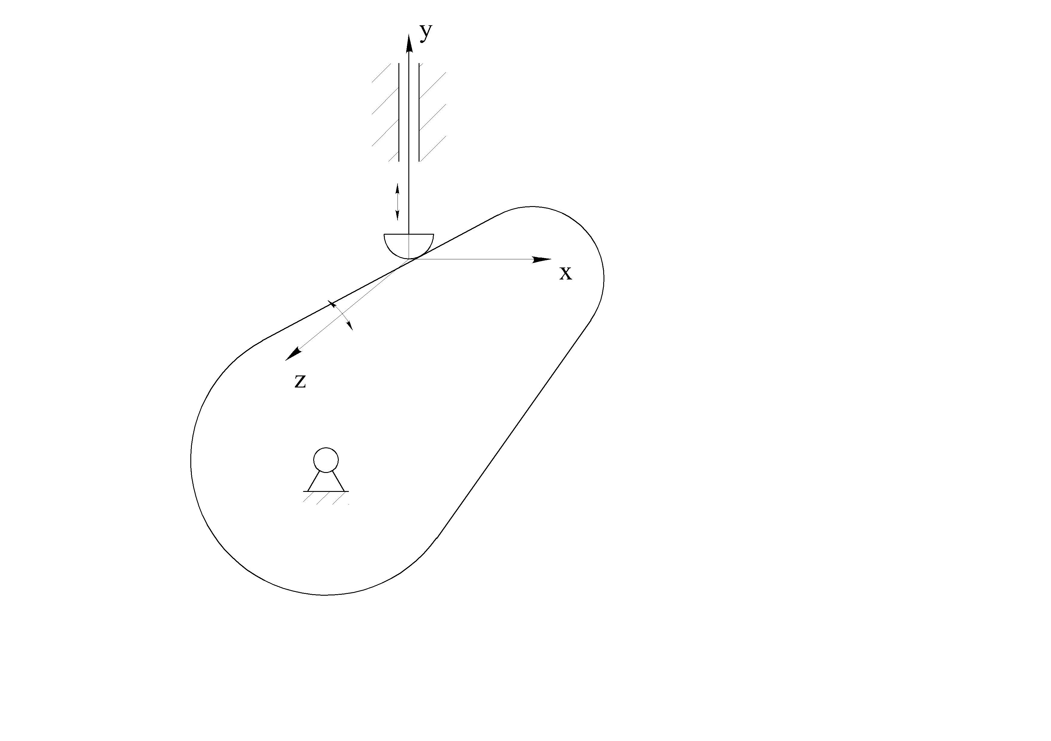
14
A cam pair (C_{p}) (Fig. 15) is similar to the gear pair except that a spring is usually used to keep the two paired elements in contact, i.e. H=2 and S=4
Fig. 15

Slide 27
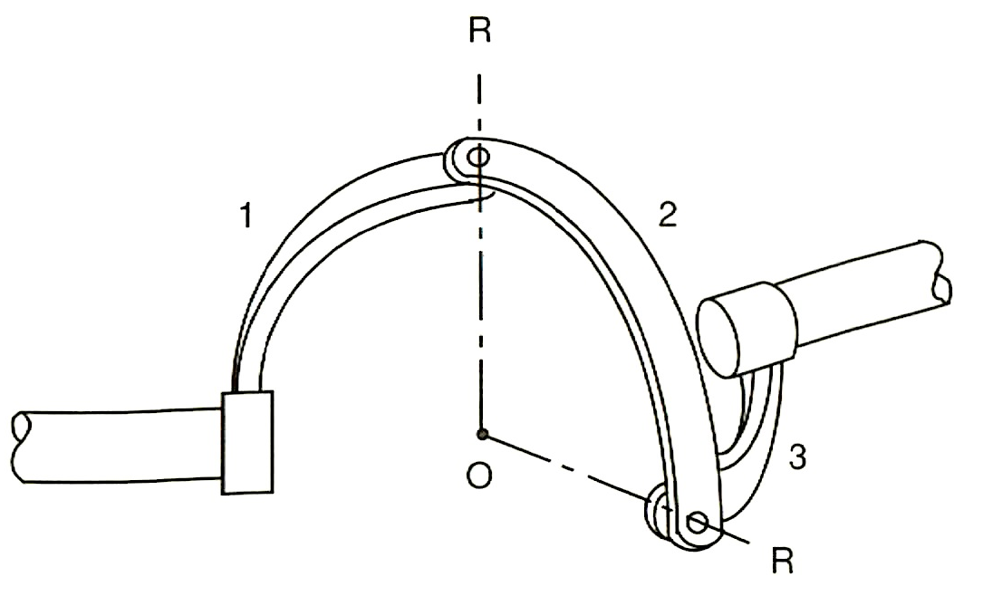
15
A universal joint (U) (Fig 16) is essentially a combination of two intersecting revolute joints. Hence H=2 and S=4.
Fig. 16

Slide 28
16
According to the number of constraints the kinematic pairs can be classified into five classes.
Number of class of a kinematic pair coincides with the number of constraints.
For example, the revolute, prismatic, helical joints belong to the joints of the fifth class, the cylindrical, gear, cam kinematic pairs belong to the kinematic pairs of the fourth class, the spherical and plane kinematic pairs belong the kinematic pairs of the third class, the gear, cam, universal kinematic pairs belong to the kinematic pairs of the second class.

Slide 29
17
According to the type of contact of the kinematic pairs elements, kinematic pairs can be classified into lower and higher pairs.
If two elements of a kinematic pair have surface contact, the kinematic pair is called a lower kinematic pair. The revolute, prismatic, cylindrical, helical, spherical, plane, universal pairs are the lower kinematic pairs. Since the two links of a lower pair are connected by a surface, the pressure between the two links is a lower.
A kinematic pair is called a higher pair if the pair elements are in contact at a point or along a line. The gear and cam pairs are the higher pairs. Since the two links of a higher pair are connected by a point or a line, the pressure between the two links is higher.

Slide 30
18
3. Kinematic Chains
An assemblage of links that are connected by joints is called a kinematic chain. The kinematic chains are subdivided into the plane (or planar) and spatial kinematic chains, the closed – loop and open – loop kinematic chains.
In plane kinematic chain all moving links have motion parallel to one fixed plane if one link is fixed. Plane kinematic chains with revolute joints are shown in Fig. 17
Fig. 17
a)
b)
c)
d)

Slide 31
19
In spatial kinematic chain all moving links have motion in intersecting planes if one link is fixed. Spatial kinematic chains with revolute and cylindrical joints are shown in Fig. 18.
Fig. 18
a)
b)

Slide 32
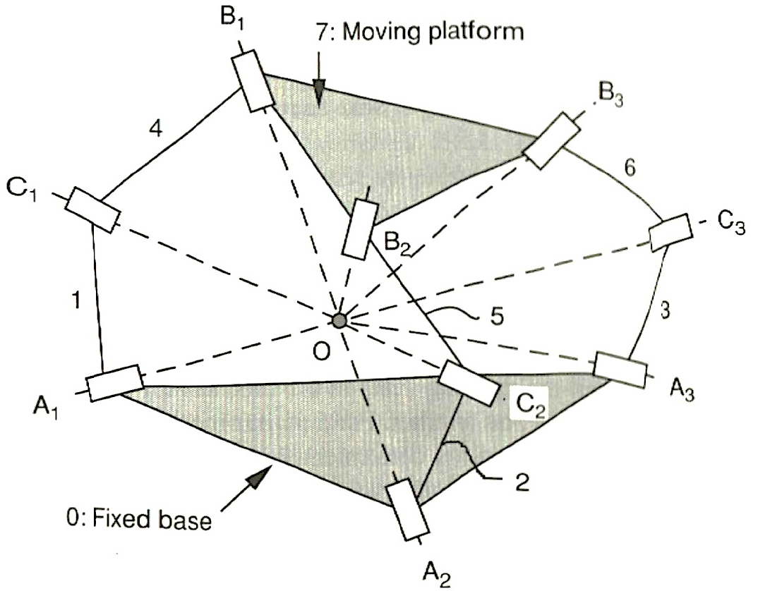
Besides the planar and spatial kinematic chains, the spherical kinematic chains can be exist which axes of links rotation intersect in one point. All points of the spherical kinematic chains have trajectories on the spherical surfaces. The spherical four link kinematic chain is shown in Fig. 19.
Fig. 19
20

Slide 33
If every link in a kinematic chain is connected to every other link by at least two pair elements, the kinematic chain forms one or more closed loops and is called a closed-loop kinematic chain.
It is also possible for a kinematic chain to be made up of both closed and open-loop kinematic chains. Such a kinematic chain is called a hybrid kinematic chain.
The kinematic chains that shown in Fig. 20 a, b and Fig. 18 b belong to the closed-loop kinematic chains.
The kinematic chains that shown in Fig. 20 c and Fig.18 b belong to the open-loop kinematic chains.
The kinematic chain that shown in Fig. 20 d is the hybrid kinematic chain.
Fig. 20
21
a)
b)
c)
d)

Slide 34
1
Lecture 3. MECHANICS OF THE ROBOT MANIPULATORS.
DEGREES OF FREEEDOM
Topics:
1. Degrees of Freedom
2. Mechanisms
3. Robot Manipulators
4. Wrist Mechanisms and Grippers

Slide 35
1. Degrees of Freedom
Location of a rigid body in space are defined by six independent parameters: three coordinates of a origin of the coordinate system fixed in the rigid body and three Euler`s angles (Fig.1). These parameters are called the generalized coordinates.
Fig.1
2

Slide 36
Let`s consider a spatial kinematics chain with n moving links. As every link has 6 generalized coordinates then this coordinates kinematics chain has 6n generalized.
Each one movable kinematic pair, i.e. the kinematic pair of the fifth class imposes five constraints, the kinematic pair of the fourth class imposes four constaints, and so on.
3
Hence, the DOF of the spatial kinematic chain is defined by formula
where n is number of moving links of the kinematic chain, is number of kinematic pair of the k - th class.
Formula (1) is called the Somov`s – Malyshev`s formula.
(1)

Slide 37
Every moving link of the planar kinematic chain has three DOF, and the kinematic pairs may be only the fifth and the fourth classes. Hence, the DOF of the planar kinematic chain is defined by formula
(2)
Formula (2) is called the Chebyshev`s formula.
4

Slide 38
DOF of the kinematic chain can be defined also by the Grubler and Kutzbach criterion where is the DOF of the space in which a kinematic chain is intended to function: = 6 for spatial kinematic chain, = 3 for planar and spherical kinematic chain, n is number of links of a kinematic chain, j is number of joints in a kinematic chain, f_{i} is degrees of relative motion permitted by joint i.
Grubler and Kutzbach criterion actually coincides with the Somovs`s – Malyshev`s and Chebyshev`s formulas. But in the Somovs`s – Malyshev`s and Chebyshev`s formulas via n denotes the number of moving links of the kinematic chain, and in the Grubler and Kutzbach criterion via n denotes the total number of the kinematic chain links including the base.
5
(3)

Slide 39
Let define the number of DOF of the kinematic chains shown in Figs. 2 and 3 when one of links is fixed.
6
a)
b)
c)
a)
Fig.2
b)
Fig.3

Slide 40
Number of DOF of the planar kinematic chains are defined by Chebyshev`s formula: a) for the four-bar closed-loop kinematic chain ABCD of type 4R when the link 4 is fixed. (Fig.2a), where n=3, = 4
(3) b) for the five-bar closed-loop kinematic chain ABCDE of type 5R when the link 5 is fixed (Fig.2b), where n = 4, = 5
(4) c) for the three-bar open kinematic chain ABC of type 2R when one of elements if the joint А is fixed (Fig.2c), where n = 2, p₅ = 2
(5)
7

Slide 41
Number of DOF of the spatial kinematic chains are defined by the Somov`s – Malyshev`s formula: a) for the four - bar closed – loop kinematic chain ABCD of type RCCC when link 4 is fixed (Fig.3a), where n = 3, p₄ = 3, p₅ = 1 b) for the three – bar open kinematic chain ABC of type when one of elements of the joint A is fixed (Fig.3b), where n = 2, p₄ = 1, p₅ = 1
8
(6)
(7)

Slide 42
d) for the four – bar spatial closed – loop kinematic chain ABCD of type
RCCC (Fig.3a), where λ = 6, n = 4, j₁ = 1, j₂ = 3
10
(11)
е) for the three – bar planar open kinematic chain ABC of type RC
(Fig.3b), where λ = 6, n = 3, j₁ = 1, j₂ = 1:
(12)

Slide 43
Number of DOF spherical four – bar kinematic chain (Fig.4) is defined similary the four – bar planar kinematic chain of type 4R (Fig.2a).
Fig.4
11

Slide 44
Binary links having the passive DOF may be present in the kinematic chains, for example, the binary link of type SS can rotate around an axis passing through the centers of the spherical joints. Therefore the passive DOF should be subtracted from the active DOF defining by Somov`s – Malyshev`s formula or Grubler and Kutzbach criterion
12
(13)
(14)
Where and are number of passive DOF.

Slide 45
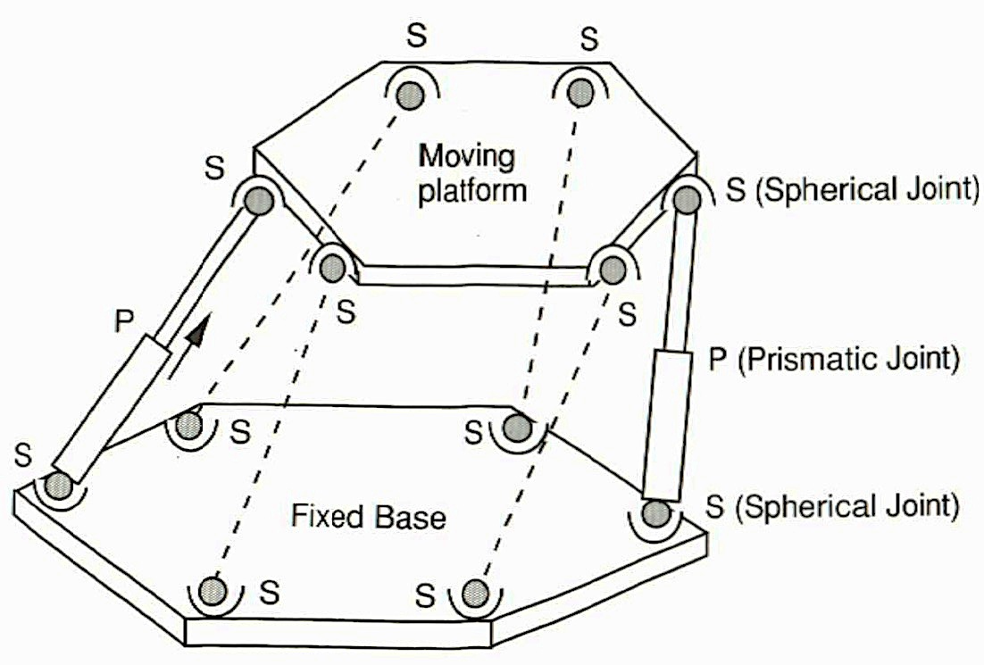
For example, define the number of DOF of Stewart – Gough Platform (Fig.5), representing the spatial kinematic chain where a moving platform is connected with a base by six legs.
13
Fig.5

Slide 46
Each leg consists of a spatial dyad of type SPS and has one passive DOF.
Then by the Somov`s – Malyshev`s formula in n=13, , we obtain
According to the Grubler and Kutzbach criterion in λ = 6, n = 14, j₁ = 6, j₃ = 12, = 6 yields
14
(15)
(16)

Slide 47
15
2. Mechanisms
Mechanisms is a kinematic chain one link which is fixed, and it transforms the given motions of one or more links to the required motions of one or more other links.
A link the law of the motion which is given is called an input link. Number of the possible motions of the input link is defined by the number of GOF of mechanism.

Slide 48
If we choose the link 1 of the for-bar kinematic chains of type 4R and type RCCC having one DOF; links 1 and 4 of the five-bar kinematic chains of type 5R (Fig.2b) and the links 1 and 2 of the three-bar kinematic chain of type 2R (Fig.3c) having two DOF; and of kind RC having three DOF as the input links then we obtain the planar and spatial mechanisms with one, two and three DOF (Fig.6a,b,c,d,e).
Fig.6
The input links are denoted by vectors showing the directions of possible motions.

Slide 49
16
The spatial mechanism of type RC having three DOF (Fig.5e) is a mechanism with two input links 1 and 2. In this case the link 1 has one possible motion (rotation about the axis of the revolute joint A), and the link 2 has two possible motions (rotation and translation about and along the cylindrical joint B).

Slide 50
3. Robot Manipulators
If to supply the link 3 of the three-and five-bar mechanisms of types (Fig.5b,c,e) by the end-effector , which is an input link, then we obtain the robot manipulators (Fig.6).
Hence, the robot manipulators are mechanisms with many DOF and their research is made by the methods of theory of mechanisms and machines.
17
Fig.6

Slide 51
18
The point Р, of the manipulators showed in Fig.6 a,b moves on the plane OXY. Motion of the point Р in the space OXYZ of the planar manipulators 2R and 5R is possible if to rotate the base about the vertical axis (Fig.7).
Fig.7

Slide 52
19
The manipulators shown in Fig.6 and Fig.7, don’t provide fully orientation of the manipulating object in space. These manipulators provide a delivery of the manipulating object to the predetermined point, and they are called an arm of the manipulator. For fully orientation of the manipulating object the wrist mechanism is installed in the point P .

Slide 53
4. Wrist Mechanisms and Grippers
A robot manipulator needs at least 6 DOF to manipulate an object freely in space. The first three moving links are used for manipulating the position, and they are called the arm of manipulating robot.
20
The last three links are used for the orientation of the end-effectors, and they are called the wrist. Furthermore the last three joint axes often designed to intersect at a common point called the wrist center. For example, the first three links 1,2,3 of the Fanuc-S-900W robot (Fig.8) are the arm, and the last three links 4,5,6 are the wrist.
Fig.8

Slide 54
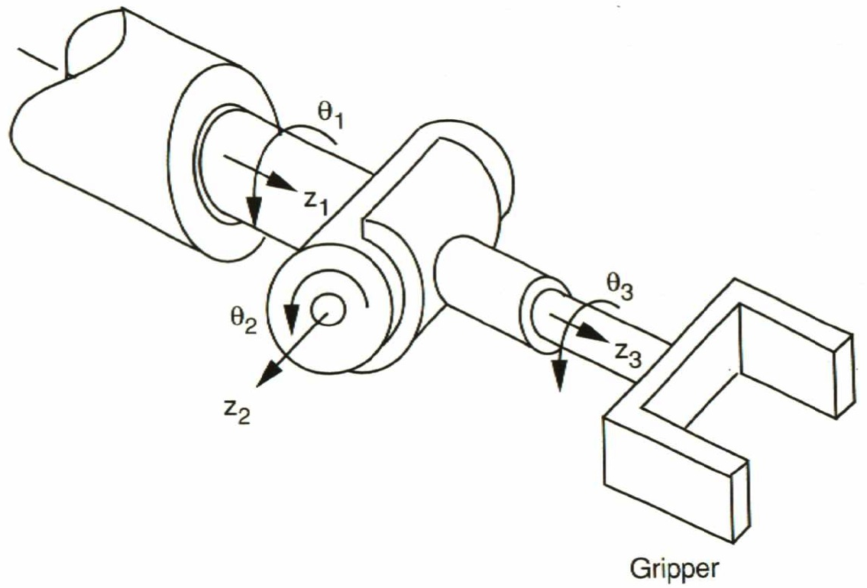
Figure 9 shows the kinematic structure of a 3 DOF serial wrist mechanism with three intersecting joint axes.
The third link of the wrist mechanism has a gripper that is used for handling a few objects of similar shape, size and weight.
21
Fig.9

Slide 55
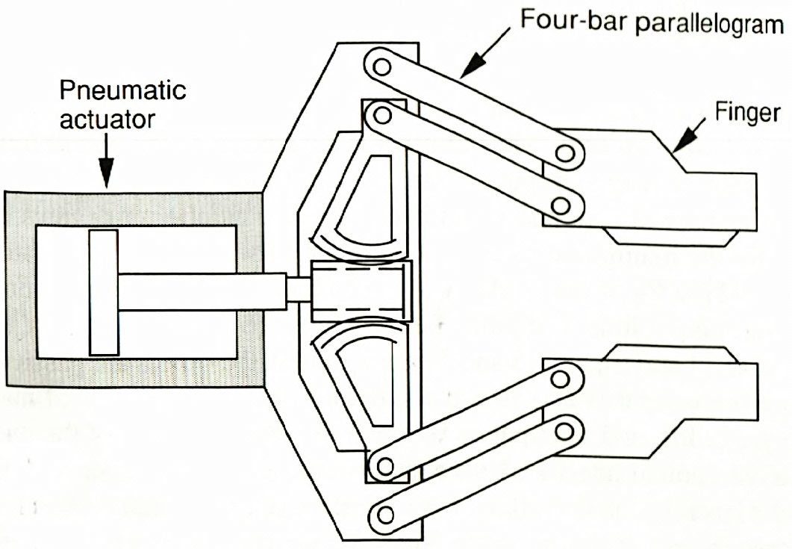
22
Grippers can be the simple grippers having one DOF and the universal grippers having many DOF and some sensing elements.
Figure 10 shows a simple gripper with one DOF driven by a pneumatic source.
Fig.10

Slide 56
Figure 11 shows a universal gripper or dexterous hand with mechanical and sensing components.
Devices attached at the output link of the robot manipulator also are called end-effectors.
23
Fig.11

Slide 57
1
Lecture 4. CLASSIFICATION OF ROBOTS
Topics:
Classification by Degrees of Freedom
2. Classification by Kinematic Structure
3. Classification by Drive Technology
4. Classification by Workspace Geometry
5. Classification by Motion Characteristics

Slide 58
2
Robots can be classified according to various criteria, such as their degrees of freedom, kinematic structure, drive technology, workspace geometry and motion characteristics.
Classification by Degrees of Freedom
Ideally, a manipulator should possesses 6 DOF in order to manipulate an object in three-dimensional space.
From this point of view, we call a robot a general-purpose robot if it possesses 6 DOF, a redundant robot if it possesses more than 6 DOF, and a deficient robot if it possesses less than 6 DOF.

Slide 59
3
A redundant robot provides more freedom to move around obstacles and operate in tightly confined workspace.
On the other hand, for some special application, such as assembling components on a plane, a robot with just 4 DOF would be sufficient.
The Fanuc S-900W robot (Fig.1) is a 6 DOF general-purpose manipulator.
Fig.1

Slide 60
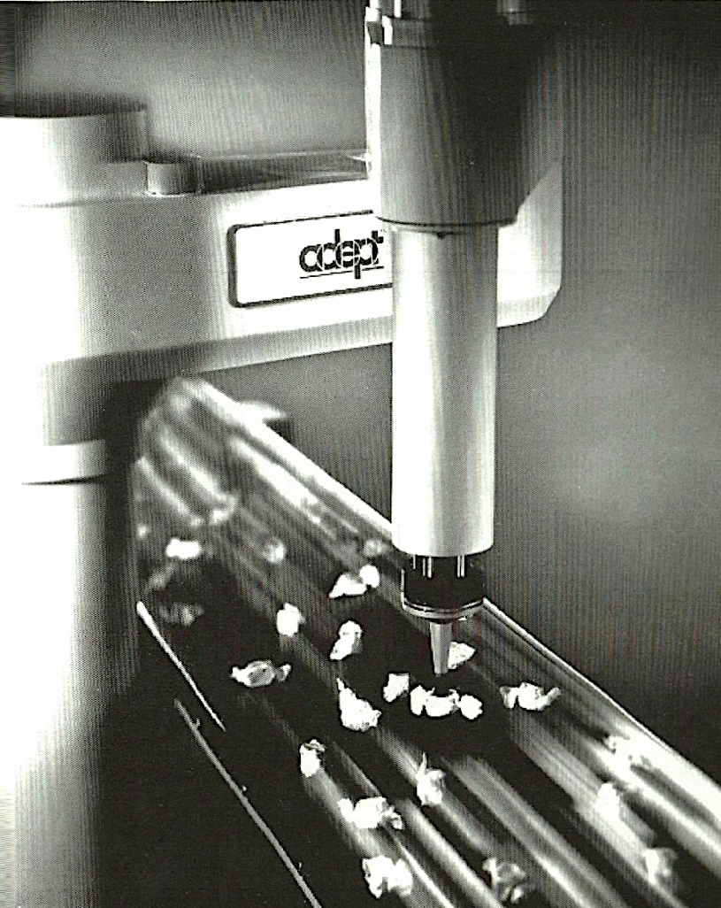
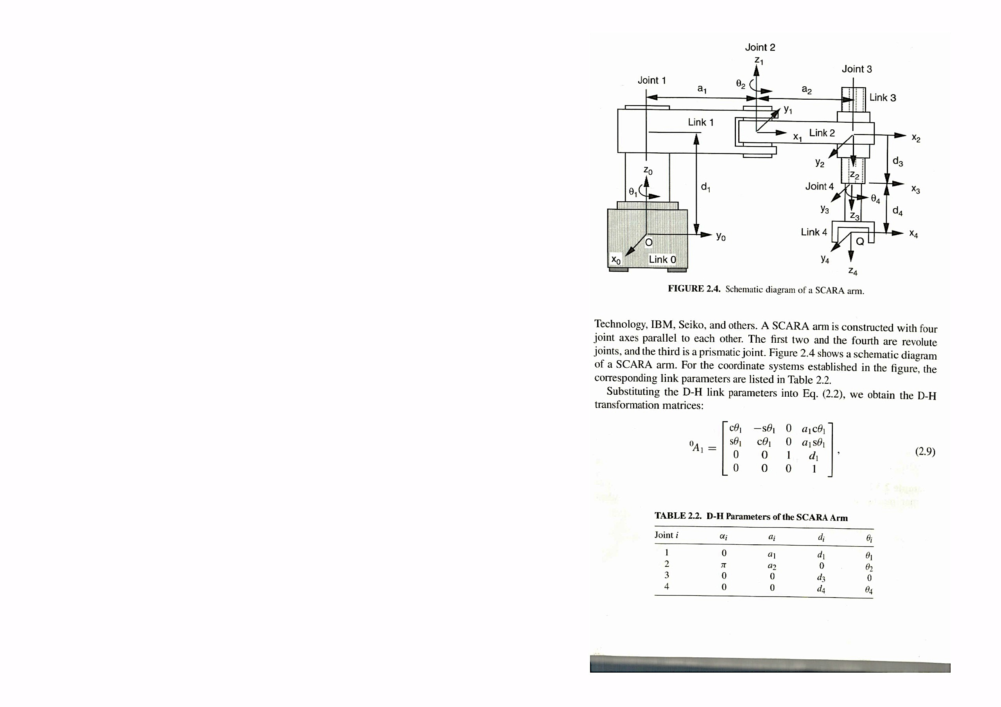
4
The Adept-One robot (Fig.2) and SCARA (Selective Compliant Articulated Robot for Assembly) robot are (Fig.3) are the 4 DOF manipulators.
Fig.2
Fig.3

Slide 61
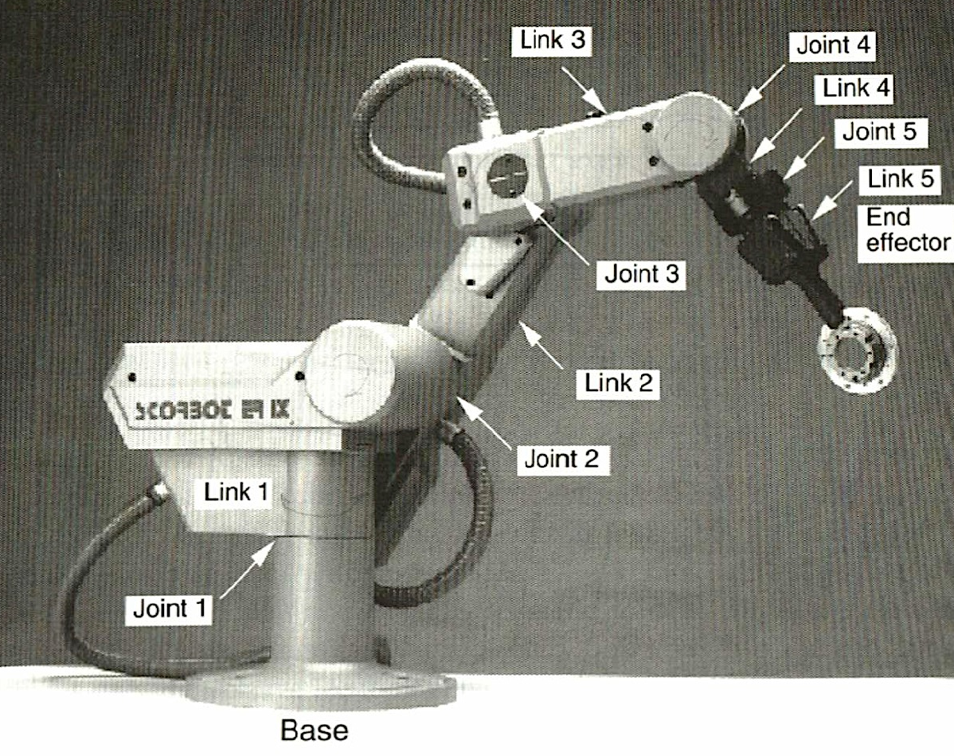
5
2. Classification by Kinematic Structure
According to the kinematic structures the robots are classified into
- a serial robot or open-loop manipulator
a parallel manipulator
a hybrid manipulator.
A robot is said to be a serial robot or open-loop manipulator if its kinematic structure takes the form of an open-loop chain.
For example, the Scorbot robot shown in Fig.4 is a serial robot.
Fig.4

Slide 62
If a robot is made up of closed-loop chain this robot is called a parallel manipulator or a parallel robot. For example, the Stewart-Gough platform shown in Fig.5 is a parallel manipulator.
Fig.6
In general, a parallel manipulator has advantages of higher stiffness, higher payload capacity , and lower inertia to the manipulation, at the price of a smaller workspace and more complex mechanism.
6
Fig.5

Slide 63
7
If a robot consist of both open-and closed-loop chains this robot is called a hybrid robot or a hybrid manipulator. Most engineers consider the Fanuc S-900W robot shown in Fig.6 to be a serial manipulator.
In reality, it is a hybrid manipulator, since it incorporates a four-bar (push-rod) linkage to drive the third joint.
Many industrial robots employ this type of construction because it allows the third motor to be mounted on the waist and therefore reduces the inertia of the manipulator.
Fig.6

Slide 64
8
3. Classification by Drive Technology
The three popular drive technologies are used in robots:
Electric
Hydraulic
pneumatic .
Most manipulators use either electric dc servomotors or stepper motors, because they are clean and relatively easy to control.
For example the Fanuc S-900W has an electric drive technology.

Slide 65
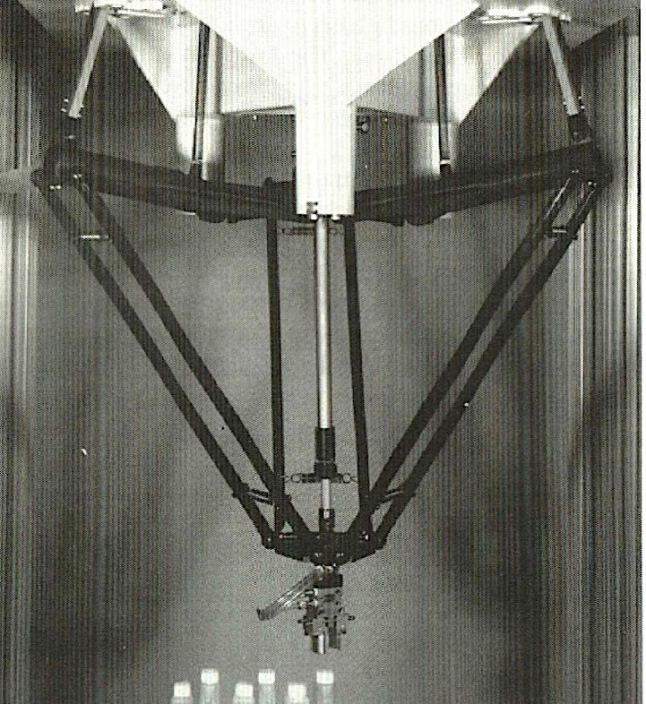
When high-speed and/or high-load-carrying capabilities are needed, hydraulic or pneumatic drive is preferred.
9
For example, the Stewart-Gough platform having a higher payload capacity has a hydraulic drive.
A major disadvantage associated with the use of a hydraulic drive is the possibility of leaking oil.
A pneumatic drive is clean and fast,it is difficult to control because air is a compressible fluid.
For example, the Delta robot (Fig.7) has a pneumatic drive.
Fig.7

Slide 66
10
4. Classification by Workspace Geometry
The workspace of a manipulator is defined as the volume of space the end-effector can reach.
Two different definition of workspace are frequently used:
a reachable workspace
a dexterous workspace.
A reachable workspace is the volume of space within which every point can be reached by the end-effector in at least one orientation.
A dextrous workspace is the volume of space within which every point can be reached by the end-effector in all possible orientations.
Clearly, the dextrous workspace is a subset of reachable workspace.

Slide 67
11
Many serial manipulators are designed with their first three moving links longer than the remaining links.
Thus the first three links are used primarily for manipulating the position and the remaining links for controlling the orientation of the end-effectors.
For example, the links 1,2 and 3 of the Fanuc robot (Fig.8) are used for manipulating the position and the remaining links 4,5 and 6 are used for controlling the orientation on of the end-effectors.
Fig.8

Slide 68
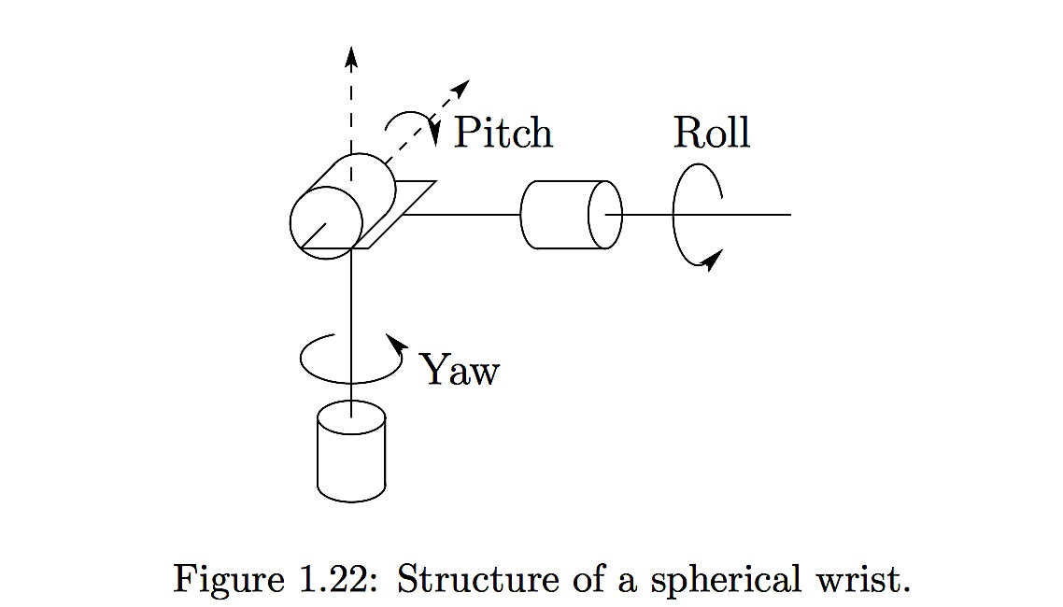
For this reason the subassembly associated with the first three links is called the arm and the subassembly associated with remaining links is called the wrist. Except for redundant manipulators, the arm usually possesses 3 DOF while the wrist may have 1 to 3 DOF.
12
Fig.10
Fig.9
Furthermore, the wrist assembly is often designed with it's joint axes intersecting at a common point called the wrist center.
Such a special arrangement leads to complete decoupling of position from the orientation problem. In Fig.9 and Fig.10 the kinematic structures of the wrist mechanism are shown.

Slide 69
13
The arm of the manipulator permitts to reach the wrist center to the predetermined point in the space.
According to the kinematic structure of the arm the
robots are subdivided into
cartesian robot
cylindrical robot
spherical robot
articulated robot.

Slide 70
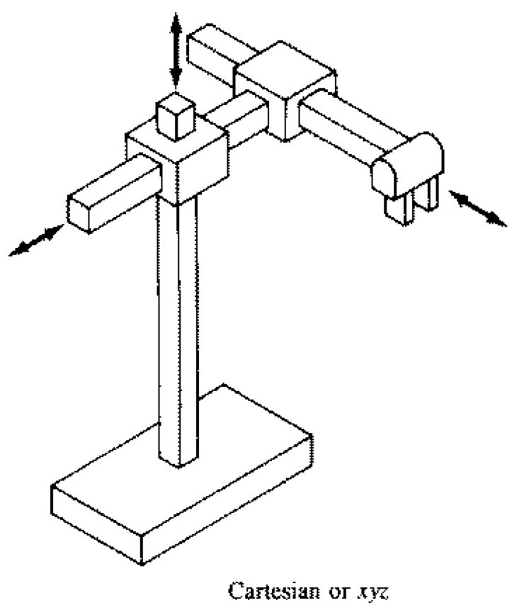
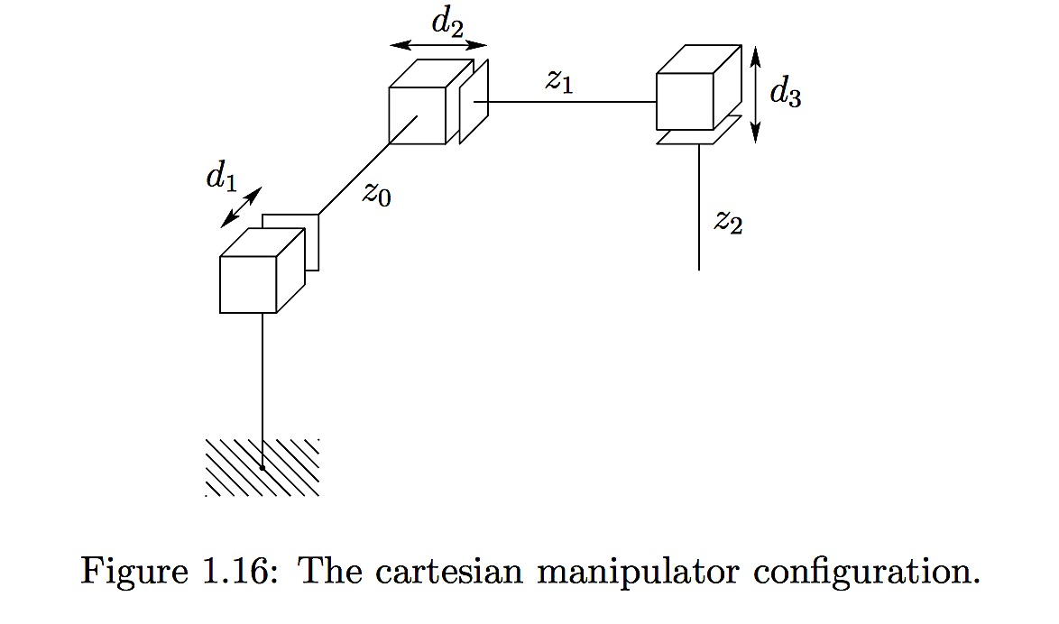
14
The wrist center of the Cartesian robot can be described by three Cartesian coordinates associated with three prismatic joints (Fig.11).
Fig.11
Fig.12
A kinematic structure of a Cartesian robot is shown in Fig.12.

Slide 71
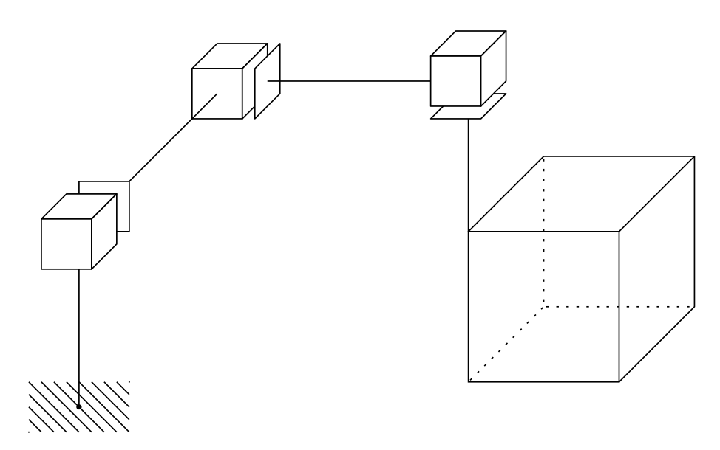
15
A Cartesian robot has PPP structure, where P is a prismatic joint.
The workspace of the Cartesian robot is rectangular box (Fig.13).
Fig.13

Slide 72
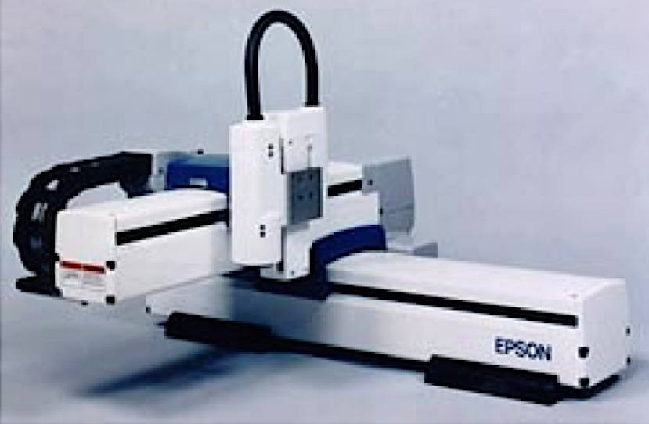
16
The Epson Cartesian Robot (Fig.14) is an example of a Cartesian Robot.
When a Cartesian robot is mounted on rails above its workspace, it is called a gantry robot.
Fig.14

Slide 73
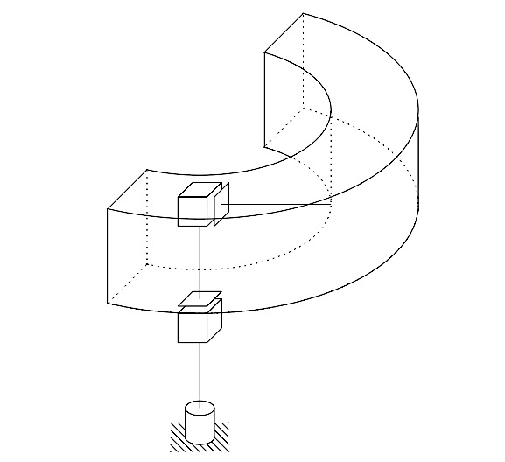
17
If either the first or second prismatic joint of a Cartesian robot is replaced by a revolute joint this root is called a cylindrical robot
In Fig.15 a cylindrical robot’s kinematic structure is shown when the first prismatic joint of a Cartesian robot is replaced by a revolute joint.
Fig.15

Slide 74
18
In Fig.16 a cylindrical robot’s kinematic structure is shown when the second prismatic joint of a Cartesian robot is replaced by a revolute joint.
The workspace of a cylindrical robot is confirmed by two concentric cylinders of finite length (Fig .15 and Fig.16).
Fig.16

Slide 75
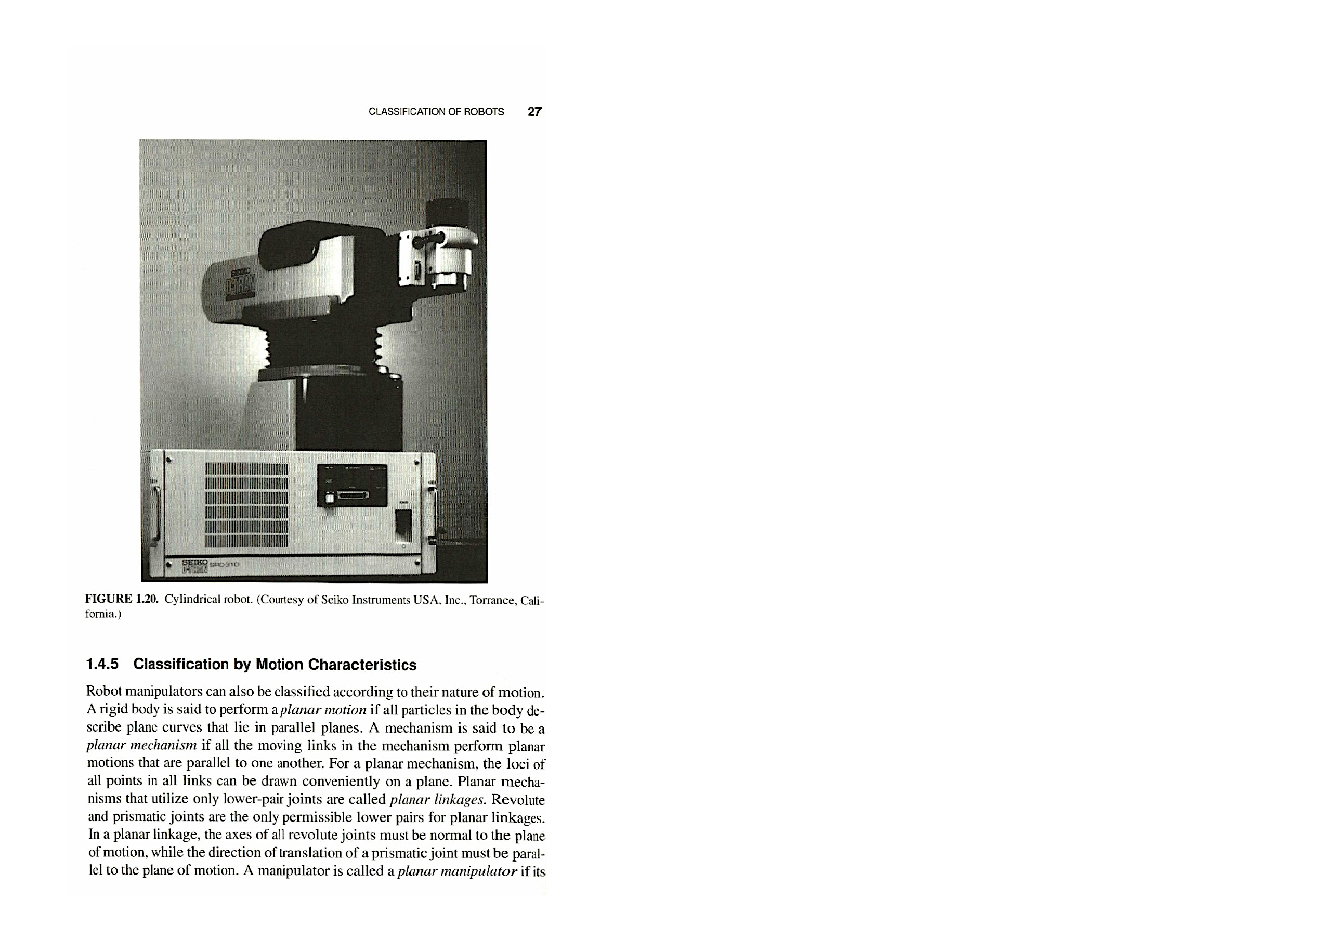
19
The first cylindrical robot has RPP structure, and the second cylindrical robot has PRP structure, where R is a revolute joint.
The Seiko Robot (Fig.17) is an example of a cylindrical robot with structure RPP.
Fig.17

Slide 76
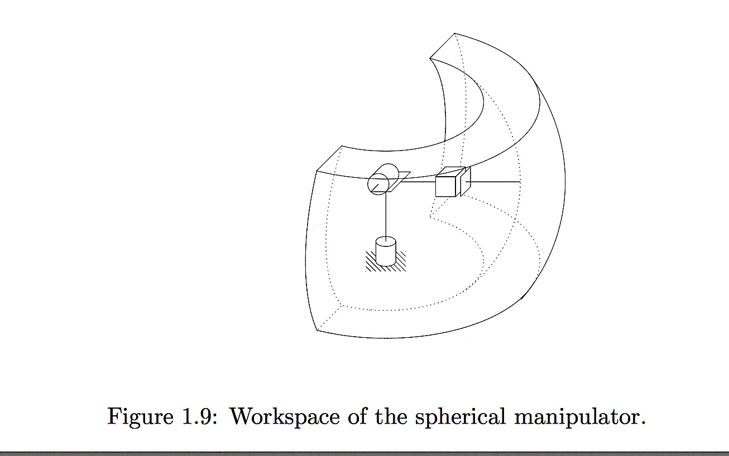
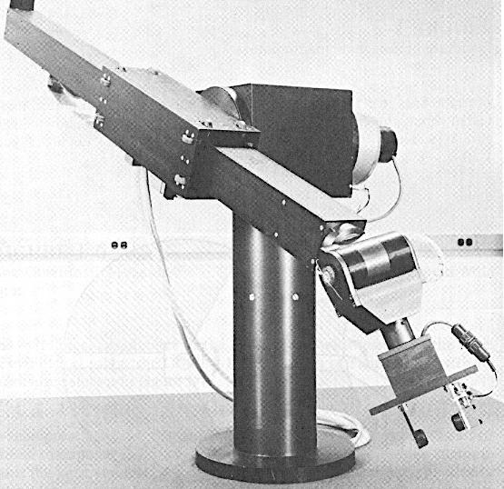
A robot arm is called a spherical robot if the first two joints are made up of two intersecting revolute joints and the third is a prismatic joint.
Normally, the prismatic joint is not parallel to the second joint axis.
The wrist center position of a spherical robot can be described by a set of spherical coordinates associated with three joint variables. Hence the workspace of spherical robot is confirmed by two concentric spheres. A spherical robot has RRP structure. Kinematic structure of a spherical robot and its workspace are shown in Fig.18
20
Fig.18
Fig.19
Fig.19 shows the Stanford Arm, one of the most well-known spherical robots.

Slide 77
A robot arm is said to be an articulated robot if all three joints are revolute. Many industrial robots are of the articulated type, for example , Fanuc Robot, PUMA Robot , Scorbot Robot (Fig.20) .
An articulated robot arm also is called anthropomorphic manipulator, elbow manipulator and RRR robot.
21
Fig.20

Slide 78
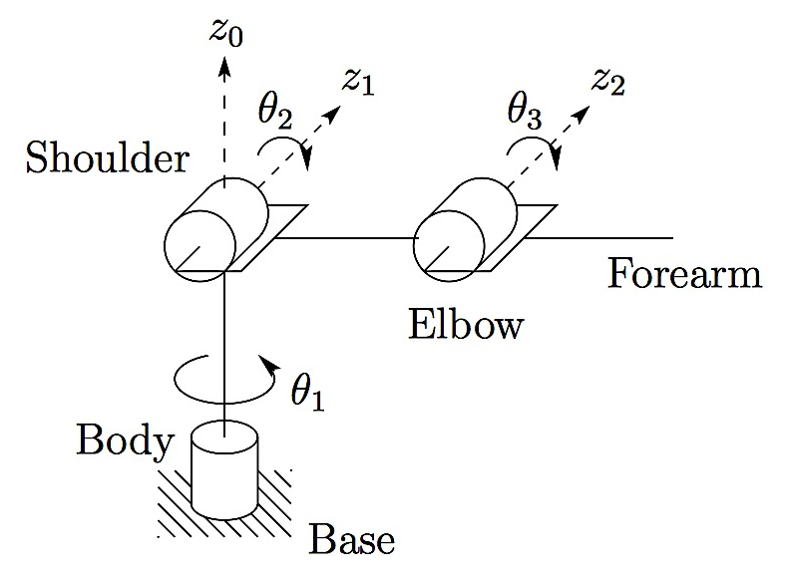
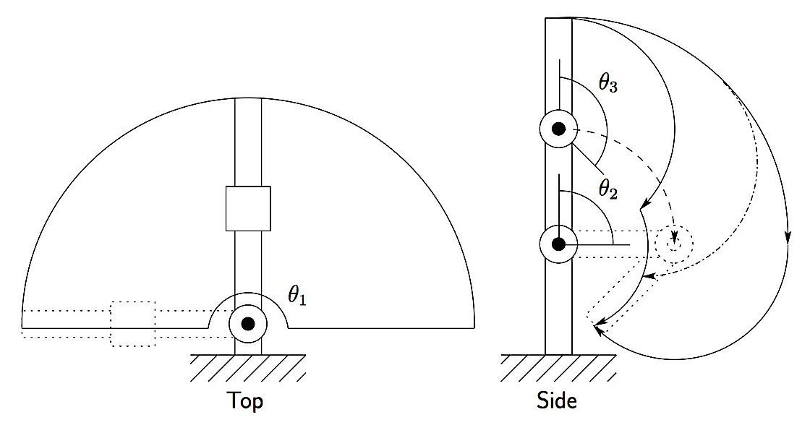
22
The workspace of an articulated robot is very complex, typically a crescent-shaped cross section.
The kinematic structure of the elbow manipulator and its workspace are shown in Fig.21 and Fig.22
Fig.21
Fig.22

Slide 79
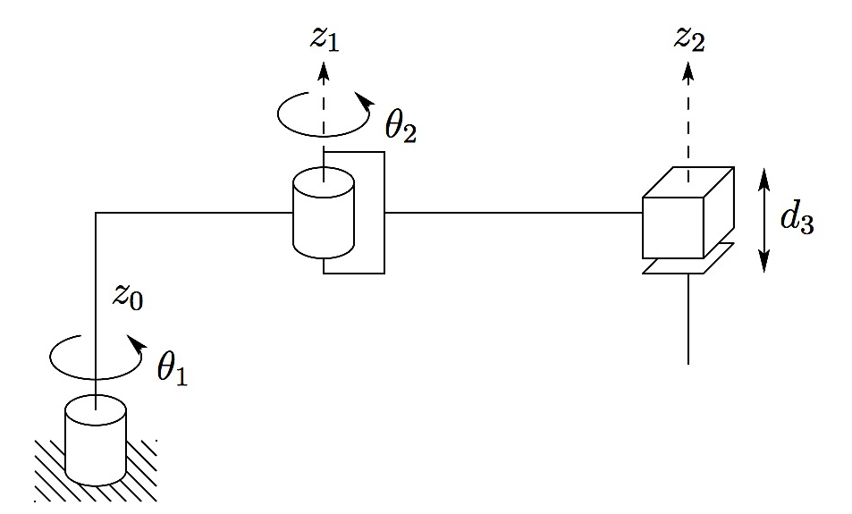
23
The SCARA (Selective Compliance Assembly Robot Arm) robot is a special type of robot. It consists of two revolute joints followed by a prismatic joint.
In addition, all three joint axes are parallel to each other and usually point along the direction of gravity. Thus the first two actuators do not have to work against the gravitational forces of the link and the payload.
Fig.23 shows the kinematic structure of the SCARA robot .
Fig.23

Slide 80
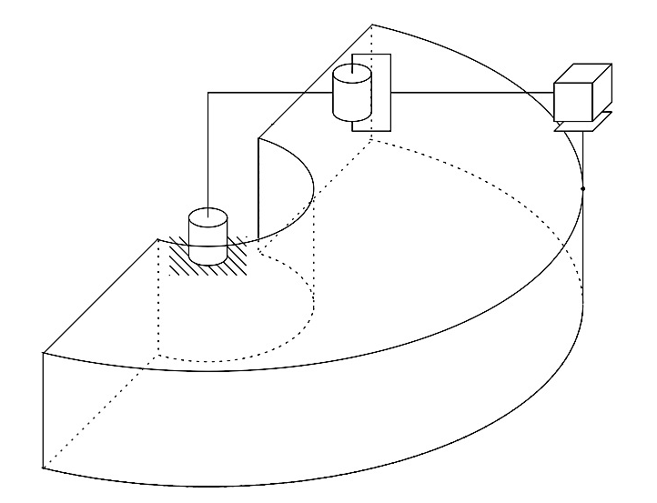
24
The SCARA robot workspace is shown in Fig.24
The SCARA robot has a RRP structure as the spherical robot. But the three axis of the spherical robot are mutually perpendicular, and the three axis of the SCARA robot are parallel.
The wrist of the SCARA robot usually has only one DOF. Hence the SCARA robot has four DOF.
This type of robots is useful for assembling parts on a plane.
Fig.24

Slide 81
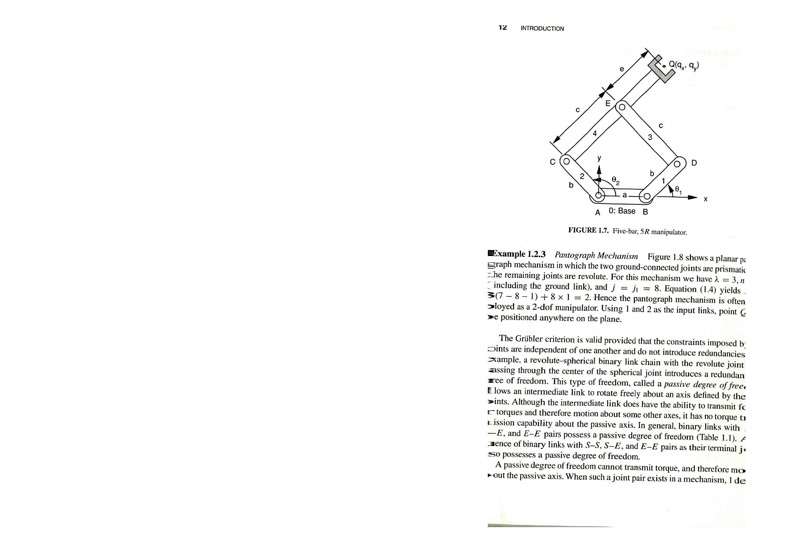
5. Classification by Motion Characteristics
According to the nature of motion of links robot manipulates can be classified:
planar manipulator
spherical manipulator
spatial manipulator.
25
A manipulator is called a planar manipulator if its moving links perform planar motion that are parallel to one another.
For example the 5R manipulator shown in Fig.25 is a planar manipulator.
Fig.25
Planar manipulators are useful for manipulating an object on a plane.

Slide 82
26
A manipulator is called a spherical manipulator if its moving links perform spherical motion about a common stationary point.
A revolute joint is the only permissible lower-pair joint for the construction of spherical manipulator.
A spherical manipulator can be used as a pointing device.
In addition, all the joint axes of a spherical manipulator must intersect at a common point.
Fig. 26 shows a 3-DOF spherical parallel manipulator.
In this manipulator all the revolute joints axes intersect at a common center point O. Links 1, 2 and 3 are considered as the input links, and link 7 designated as the output link.
Fig.26

Slide 83
27
A manipulator is called a spatial manipulator if at least one of the moving links in the manipulator possesses a general spatial motion. The manipulators shown in Fig.27 is a spatial 6-DOF parallel manipulator.
Fig.27

Slide 84
1
Lectures 5-8. PROBLEMS OF KINEMATICS OF THE ROBOT MANIPULATORS. HOMOGENEOUS TRANSFORMATIONS
Topics:
1. Problems of Kinematics
2. Position, Orientation, and Location of a Rigid Body
3. Description of a Position
4. Description of a Location
5. Homogeneous Transformations

Slide 85
2
Problems of Kinematics
Kinematics deals with the aspect of motion regard to the forces and/or torques that cause it.
The science of kinematics deals with the position, velocity and acceleration with respect to time. Hence kinematics is concerned only with the geometrical and time of properties of a motion.

Slide 86
The joint variables of a robot manipulator are related to the position and orientation of the end-effector. For example, the variables angles of the 6 revolute joints of the Fanuc robot (Fig.1) are related to the position and orientation of the end-effector.
3
Fig.1

Slide 87
The kinematic relations between the position and orientation of the end-effector and the joint variables are necessary for the design and control of robot manipulators.
There are two types of kinematic analysis of robot manipulators:
direct kinematics
inverse kinematics
In the programming of a robot manipulator, typically a set of desired positions and orientations of the end-effector are specified in space.
The problem is to find all possible sets of actuated joint variables and their corresponding time derivatives which will bring the end-effector to the set of desired positions and orientations, with the desired motion characteristics. This problem is called an inverse kinematics.
On the other hand, sometimes the actuated joint variables and possibly their time derivatives are obtained from readings of sensors installed at the joints, from which we wish to find all possible sets of end-effector positions and orientations and their corresponding time derivatives. This problem is called direct kinematics or forward kinematics.
4

Slide 88
For example, in inverse kinematics of the Fanuc robot (Fig.1) the set of variable parameters of the actuated joints 1.2..., 6 are obtained at the set of desired positions and orientations of the end-effector.
5
In direct kinematics of the Fanuc robot the set of positions and orientations of the end-effector are obtained at the set of variable parameters at the actuated joints 1,2,.....6.
Fig.1

Slide 89
2. Position, Orientation, Location of a Rigid Body
In the study of the kinematics of the robot manipulators, we are dealing with the location of several bodies in space. The bodies of interest include the links of a manipulator, the tools, the work pieces and so on.
To identify location of a body, a reference coordinate system is established. This reference coordinate system is called the fixed frame. A Cartesian coordinate system may be used as the fixed frame (Fig.2) .
Fig.2
6

Slide 90
If a body of interest is rigid, six independent parameters would be sufficient to describe its location in three-dimensional space.
We also attach an Cartesian coordinate system to the moving body and refer to it as the moving frame (Fig.2).
Then the relative location of the Cartesian coordinate system can be considered as composed of the position of the origin Q, and the orientation of the moving frame with respect to the fixed frame.
7
Fig.2

Slide 91
3. Description of a Position
The position of any point with respect to the reference frame can be described by a 3x1 position vector. For example, the position of a point P in the reference frame A as shown in Fig.3 to written as
(1)
where the subscripts represent the projections of the point P or the vector onto the three coordinate axes of the reference system.
8
Fig.3

Slide 92
9
4. Description of an Orientation
To describe the orientation of a rigid body, we consider the motion of a moving frame B with respect to a fixed frame A with one point fixed. This is known as a rotation or a spherical motion.
There are direction cosines representation and Euler angles representation of orientation.

Slide 93

10
5. Direction Cosines Representation
Let denote three unit vectors pointing along the axes of the system of coordinate axes of the fixed frame A and denote three unit vectors pointing along the axes of the system of coordinate axes of the moving frame B respectively, as shown in Fig.4.
Ouvw
Fig.4

Slide 94


The position vector of a point P of the rigid body can be expressed either in the fixed frame A as
(2)
and in the rotated frame B as
(3)
where and are the projections of the vector into the axes of the coordinate system and the coordinate system
respectively.
Since P is a point of the rigid body, is constant, i.e
However, depends on the orientation of B relative to A.
11

Slide 95

12
Using the definition of scalar multiply of two vectors the projections of the vector can be defined by expressions
(4)
Indeed
(5)
Since then substituting the expression (3) in Eqs (4) we obtain
(6)

Slide 96
13
Writing Eqs (6) in matrix form we obtain
(7)
where
(8)
The matrix is called the rotation matrix of the moving frame B with respect to the fixed frame A . It transforms the position vector of any point P of the moving frame B to fixed frame A .

Slide 97
14
Similarly, the position vector can be defined from the position vector
(9)
where
(10)
The matrix transforms the position vector of any point P from the fixed frame A to the moving frame B.

Slide 98
15
The rotation matrixes and have the following properties
= = (11)
= = = , (12)
where is a unit matrix of a dimension (3x3).
On the base of a scalar multiply of two vectors we see that the elements of the rotating matrixes and cosines of the angles between the directions of the axes of coordinate systems and
. These cosines are called the direction cosines.

Slide 99
16
6. Euler Angles Representation
The direction cosines representation of an orientation contains nine parameters. Since rotation is a motion with 3 DOF, a set of three independent parameters are sufficient to describe the orientation of a rigid body in a space. Three Euler angles are used in the three-parameters representation of orientation.
In Euler angles representation, three successive rotations about the coordinate axes of either a fixed coordinate system or a moving coordinate system are used to describe the orientation of a rigid body.
For convenience , we introduce three basic rotation matrices from which an Euler angles representation can be derived in terms of their product.

Slide 100
17
When a rigid body performs a rotation about the axis, then
(Fig.5)
Fig.5
The elements of the rotation matrix have the following views
(13)
(14)

Slide 101

(15)
(16)
(17)
(18)
(19)
(20)
(21)
Hence, the rotation matrix , Eq.8, reduces to
(22)
18

Slide 102
19
When a rigid body performs a rotation of about the Ox axis, then (Fig.6)
Fig.6

Slide 103

The elements of the rotation matrix , Eq.8, have the following views
20
(23)
(24)
(25)
(26)
(27)
(28)

Slide 104
21
(29)
(30)
(31)
Hence, the rotation matrix , Eq.8, reduces to
(32)

Slide 105
22
When a rigid body performs a rotation of about the axis, then
(Fig.7)
Fig.7
The elements of the rotation matrix , Eq.8, have the follows views
(33)
(34)

Slide 106
23
(35)
(36)
(37)
(38)
(39)
(40)
(41)
Hence, the rotation matrix , Eq.8, reduces to
(42)

Slide 107
5. Description of Location
As pointed out earlier, the location of the rigid body can be described by the position of the origin Q and the orientation of the moving frame with respect to the fixed frame.
Fig.8 shows that the position of a point P of the rigid body can be expressed in the fixed frame as . It can also be expressed in the moving frame B as .
Fig.8
24

Slide 108
To derive a relation between and , we construct the vector as a sum of two vectors
(43)
where denotes the position of Q with respect to the fixed frame A.
Let the orientation of the moving frame B with respect to the fixed frame A be defined by the rotation matrix . Then Eq.(43) can be written as
(44)
Eq. (44) describes the position of a point in a rigid body in terms of the position of the origin Q and the orientation of the moving frame B with respect to the fixed frame A.
The first term on the right-hand side of Eq.(44) represents the contribution due to a rotation of the rigid body about same axis, and the second term represents the contribution due a translation along the direction of .
We observe that the general spatial displacement of a rigid body can be considered as a rotation plus a translation. This is well known as Chasles’ theorem.
25

Slide 109
6. Homogeneous Transformations
Eq. (44) provides a general transformation of a position vector from the moving frame to the fixed frame. It has two terms representing the rotation and translation separately.
Using the concepts of homogeneous coordinates and homogeneous transformation matrix the rotation and translation of the moving frame can be written in one matrix.
6.1. Homogeneous Coordinates
Let be the position vector of a point with respect to reference frame A in three- dimensional space. We define the homogeneous coordinates if as
(45)
Thus the homogeneous coordinates of a point in frame A are represented by a vector in a four-dimensional space. The fourth coordinate is a nonzero scaling factor.
26

Slide 110
27
From the definition above, we see that a three-dimensional vector can be recovered from its four-dimensional homogeneous coordinates by dividing the first three homogeneous coordinates by the fourth coordinates that is
(46)
For the kinematics of mechanisms and robot manipulators, we choose a scaling factor =1 for convenience.
When the scaling factor is set to unity, the first three homogeneous coordinates represent the actual coordinates of a three-dimensional vector. Hence the position vector of a point is given simply as
(47)

Slide 111
28
6.2. Homogeneous Transformation Matrix
The homogeneous transformation matrix is 4x4 matrix that is defined for the purpose of mapping a homogeneous position vector from one coordinate system into another.
This matrix can be partitioned into four submatrices as follows:
(48)
The upper left 3x3 submatrix denotes the orientation of a moving frame B with respect to a reference frame A.

Slide 112
29
The upper right 3x1 submatrix denotes the position of the origin of the moving frame relative to the fixed frame.
The lower left 1x3 submatrix denotes a perspective transformation.
The lower right element is a scaling factor.
(49)

Slide 113
30
For kinematics of mechanisms and robot manipulators the scaling factor is set to unity and the 1x3 perspective transformation matrix is set to zero.
Using the homogeneous coordinates, Eq. (44) can be written in the following compact from
(49)
where
(50)
(51)
(52)

Slide 114
31
For example, the homogeneous transformation matrix for a simple rotation about the z-axis is given by
(53)
The transformation matrix for a pure translation is given by
(54)

Slide 115
32
Let define the inverse homogeneous transformation matrix .
Multiplying both sides of Eq.(44) by and making of the fact that , we obtain
(55)
Using the homogeneous coordinates, Eq. (55) can be written as
(56)
Hence
(57)

Slide 116
1
Lectures 9-11. POSITION ANALYSIS OF THE SERIAL MANIPULATORS.
DENAVIT-HARTENBERG HOMOGENEOUS TRANSFORMATION MATRICES
Topics:
1. Direct Kinematics and Inverse Kinematics
2. Link Parameters and Link Coordinate Systems
3. Denavit- Hartenberg Homogeneous Transformation Matrices
4. Denavit- Hartenberg Transformation Matrices of the Planar 3- DOF
Manipulator
5. Denavit- Hartenberg Transformation Matrices of the SCARA arm
6. Loop- Closure Equations
7. Scorbot Robot Transformation Matrices
8. Other coordinate systems
9. Position Analysis of the Scorbot Robot

Slide 117
1. Direct Kinematics and Inverse Kinematics
A serial manipulator consists of links connected in series by various type of joints, typically revolute and prismatic joints.
2
One end of the manipulator is attached to the ground and the other end is free to move in space. For this reason a serial manipulator is sometimes called an open- loop manipulator.
We call the fixed link the base, and the free end where a gripper or a mechanical hand is attached, the end- effector.
For example, the Scorbot robot has a serial manipulator (Fig.1).
Fig.1

Slide 118
3
For a robot to perform a specific task, the location of the end- effector relative to the base should be established first. This is called the position analysis problem.
There are two types of position analysis problems: direct position or direct kinematics and inverse position or inverse kinematics problems.
For direct kinematics, the joint variables are given and the problem is to find the location of the end- effector.
For inverse kinematics, the location of the end- effector is given and the problem is to find the joint variables necessary to bring the end- effector to the desired location.

Slide 119
4
2. Link Parameters and Link Coordinate Systems
In general, an n – DOF serial manipulator consists of a base link and n moving links connected in series by n joints without forming a closed loop. The relative motion associated with each joint can be controlled by an actuator such that the
end- effector can be positioned anywhere within its workspace.
For example, the Scrobot robot shown in Fig. 2, is a 5- DOF serial manipulator in which the first joint axis points up vertically, the second joint axis is perpendicular to the first joint, the third and fourth joint axes are both parallel to the second joint and fifth joint axis intersects the fourth perpendiculary.
Fig.2

Slide 120
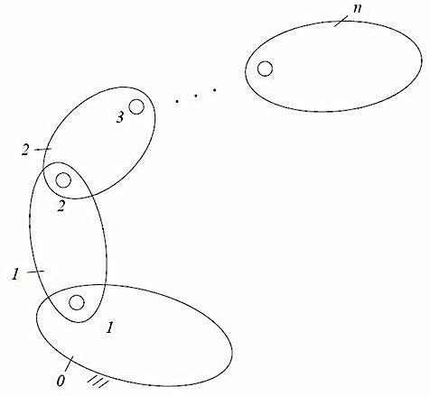
To describe the geometry of the links, starting from the base link, we number the link sequentially from 0 to n and the joint from 1 to n (Fig.3). Thus except for the base link and the end- effector link, every link has two joints.Link 1 is connected to the base link by joint 1, link 2 is connected to link 1 by joint 2, and so on.
Fig.3
5

Slide 121
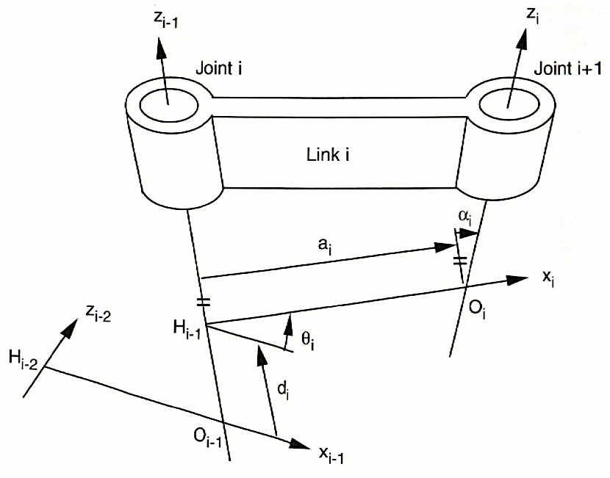
Link i has joint i at its proximal end and joint i +1 at the distal end, as shown in Fig. 4
Fig.4
6

Slide 122
7
Following Denavit and Hartenberg’s convention, a Cartesian coordinate system is attached to each link of a manipulator.
Except for the base and end- effector link coordinate system i is attached to link i according to the following rules:
The z_{i} – axes is aligned with the (i +1) th joint axes. The positive direction of rotation or translation can be chosen arbitrarily.
The x_{i} – axes is defined along the common normal between the i th and (i+1) th joint axes and points from the i th to the (i +1) th joint axes. If the two joint axes are parallel, the x_{i} – axis can be chosen anywhere perpendicular to the two joint axes. In case of intersection joint axes can be defined either in the direction of the vector cross product z_{i-1}× z_{i} or in the opposite direction, and the orign is at the point of intersection.
The y_{i} - axis is determined by the right-hand rule.

Slide 123
8
The zeroth coordinate system is attached to the base at any convenient location as long as the z₀ – axis is aligned with the first joint axis.
Furthermore, we attached a coordinate system to the end- effector link, called the end- effector or hand coordinate system, to describe the location of the end-effector.
The hand coordinate system can be located anywhere in the end- effector as long as the x_{n} – axis normal to the last joint axis.
For convenience, the z_{n} – axis is often defined along the direction of approach of a gripper.

Slide 124
9
Let H_{i-1} be the point of intersection of the x_{i} and z_{i-1} axes, and let 0_{i}, the origin of the ith coordinate system, be the point of intersection of the x_{i} and z_{i} axes as shown in Fig. 4.
Fig.4

Slide 125
10
The geometry of the link is determined by the following parameters:
a_{i} : offset distance between to adjacent joint axis where a_{i} = (H_{i-1} 0_{i})
d_{i}: translational distance between to incident normal’s of a joint axis.
is positive if the vector points in the
positive direction, otherwise, it is negative;
α_{i} : twist angle between two adjacent joint axes. It is the angle required
torotate the z_{i-1} – axes into alignment with the z_{i} – axis about the positive
x_{i} – axis according to the right- hand rule;
θ_{i}: joint angle between two incident normal’s of a joint axis. It is the angle
required to rotate the x_{i-1} – axis into alignment with the x_{i} – axis about the
positive z_{i-1} – axis according to the right- hand rule.

Slide 126
11
For a revolute joint i the parameters a_{i},α_{i}, and d_{i} are constant, and θ_{i} is a variable that measures the relative location of link i with respect to link (i-1).
For the prismatic joint i the parameters a_{i},α_{i}, and θ_{i} are constant, and d_{i} is a variable that measures the relative location of link i with respect to link (i-1).
The variable parameters θ_{i} and d_{i} are called the joint variables, and the constant parameters are called the link parameters.

Slide 127
12
Consequently, a general procedure for establishing Denavit- Hartenberg’s coordinate system can be summarized as follows:
Starting from the base link, number of links and joints sequentially. The base numbered as link 0 and last link is the end- effector. Except for the base and end- effector link, every link contains two joints. Joint i connects link i to link (i-1).
Draw the common normals between two adjacent joint axes. Except for the first and last joint axes, every joint axis should have two incident common normals, one with the (i -1)th and the other with the (i+1)th joint axis.
Establish the base coordinate system such that the z₀ – axis is aligned with the first joint axis, the x₀ –axis is perpendicular to the z₀ – axis and y₀ – axis is determined by the right-hand rule.

Slide 128
13
Establish the nth hand coordinate system such that the x_{n} – axis is perpendicular to the last joint axis. The z_{n} –axis is the usually chosen in the direction of approach of the end- effector.
Attach a Cartesian coordinate system to the distal end of all the other links as follows:
The z_{i} – axis aligned with the (i+1)th joint axis
The x_{i} – axis defined along the common normal between the ith and (i+1)th joint axes, pointing from the ith to the (i+1)th joint axes.
If the joint axes are parallel, the x_{i} – axis can be chosen anywhere
perpendicular to the joint axes.
In the case of two intersecting joint axis, the x_{i} – axis can be defined either
in the direction of the vector cross product z_{i-1}× z_{i} or in the opposite
direction, and the origin is located at the point of intersection.
Determine the link parameters and joint variables: a_{i}, α_{i}, θ_{i} and d_{i}.

Slide 129
14
3. Denavit- Hartenberg Homogeneous Transformation Matrices
Having established a coordinate system to each link of a manipulator, a 4×4 transformation matrix relating two successive coordinate system can be established.
The (i-1)th coordinate system is translated along the z_{i-1} – axis a distance d_{i}. This brings the origin 0_{i-1} into coincidence with H_{i-1}. The corresponding transformation matrix is
(1)

Slide 130
15
2. The displaced (i-1)th coordinate system is rotated about the z_{i-1} – axis an angle θ_{i}, into alignment with the x_{i} – axis. The corresponding transformation matris is
(2)

Slide 131
16
3. The displaced (i-1)th coordinate system is translated along the x_{i} – axis a distance a_{i}. This brings the orign 0_{i-1} into coincidence with 0_{i}. The corresponding transformation matrix is
(3)
4. The displaced (i-1)th coordinate system is rotated about the x_{i} – axis an angle α_{i}, which brings the two coordinate systems into complete coincident. The corresponding transformation matrix is
(4)

Slide 132
17
The resulting transformation matrix is given by
(5)
Expanding Eq. (5), we obtain
(6)

Slide 133
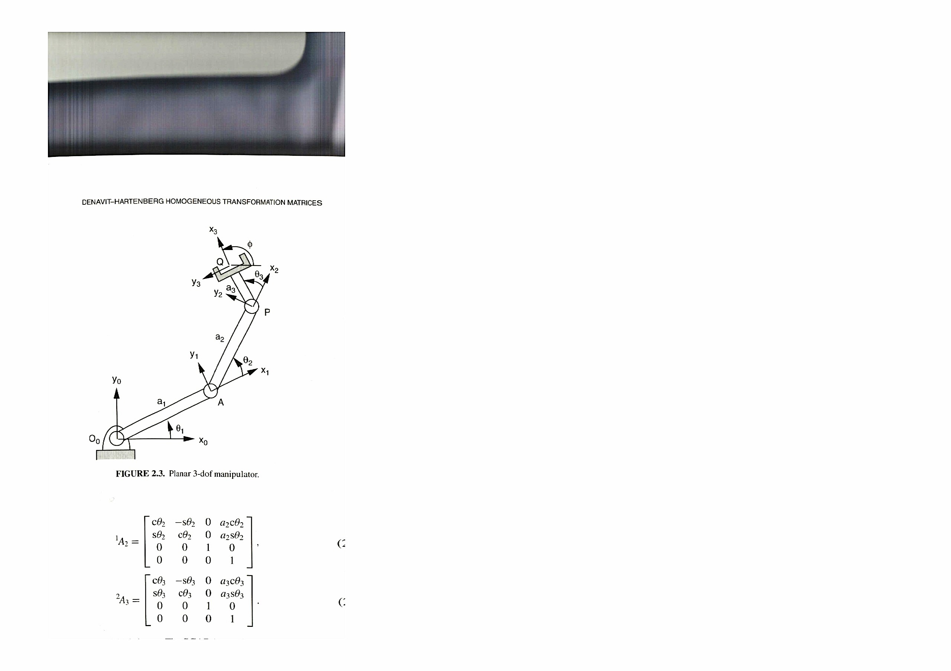
18
4. D-H Transformation Matrices of a Planar 3-DOF Manipulator
Fig.5 shows a 3-DOF planar manipulator constructed with three revolute joints located at points O_{o}, A and P, respectively.
A coordinate system is attached to each link. The O_{o}x_{o}y_{o}z_{o} coordinate system is attached to the base with its orign O_{o} located at the first joint pivot and the x_{o}- axis pointing to the right.
Since the joint axes are all parallel to each other, all the twist angles d_{i} and translational distances d_{i} are zero.
Fig.5

Slide 134
19
For the coordinate systems chosen, the link parameters are given in Table 1.
Table 1. D-H Parameters of a 3-DOF Planar Manipulator
The D-H transformation matrices are obtained by substituting the D-H link parameters into
Eq.6:
(7)

Slide 135
20
(8)
(9)

Slide 136
21
5. D-H Transformation Matrices of the SCARA arm
The SCARA(Selective Compliance Assembly Robot) arm is an important type of 4 -DOF manipulator. Fig.6 shows a schematic diagram of a SCARA arm.
The SCARA arm has been produced by several companies, including Adept Technology, IBM, Seiko , and others. It is useful for assembling parts on a plane.
Fig.6

Slide 137
22
The first two and the fourth are revolute joints, and the third is a prismatic joint.For the coordinate system established in the Fig.6, the corresponding link parameters are listed in Table 2.
Table 2. D-H Parameters of the SCARA arm
Fig.6

Slide 138
23
Substituting the D-H parameters into Eq.6, we obtain the D-H transformation matrices:
(10)
(11)

Slide 139
24
(12)
(13)

Slide 140
25
In this robot, the joint variables are and .
The first two joint variables control the x and y coordinates, the third joint variable controls the z coordinate, and the fourth joint variable controls the orientation of the end-effector.
Since the robot has only 4 DOF, it is very useful for assembling components on a plane such as a PC board.

Slide 141
26
6. Loop- Closure Equations
In a study of the kinematics of robot manipulators, we are interested in deriving an algebraic equation relating the location of the end-effector to the joint variables.
The location of the end-effector can be specified by the following 4x4 homogeneous transformation matrix:
(14)
where the upper 3x1 submatrix describes the positions of a reference point Q, and the upper left 3x3 submatrix describes the orientation of the end- effector.
The orientation of the end-effector can be specified in terms of three Euler angles, or the direction cosines of the three end-effectors coordinate axes u, ѵ and ѡ.

Slide 142
27
If the w-u-w Euler angles are used, for example, the element of the upper left 3×3 summatrix are given by
(15)
(16)
(17)
If the direction cosines are used, u, v and w represent three unit vectors directed along the three coordinate axes of the hand coordinate system and expressed in the base coordinate system.

Slide 143
28
From the geometry of the links, the transformation matrix Eq. (14), can be thought as the resultant of a series of coordinate transformation beginning from the base coordinate system to the end- effector coordinate system. This is
(18)
Eq. (18) is called the loop- closure equation of a serial manipulator.
It contains 16 scalar equations, four of which are trivial.
Equating the upper right 3×1 submatrix results in three independent equations, representing the position of the end- effector.

Slide 144
29
Equating the elements of the upper left 3×3 submatrix results in nine equations, representing the orientation of the end- effector. However, only three of the nine orientation equations are independent because of the orthogonal conditions.
The loop- closure equation , Eq. (18), can be used to solve both direct and inverse kinematics problem.
For direct kinematics, the joint variables are given and the problem is to find where the end- effector is with respect to the base coordinate system. This can be accomplished by multiplying the D-H matrices on the left- hand side of the equation.
For the inverse kinematics, the end- effector location ( i.e., ) is given and the problem is to find the joint variables needed to bring the end- effector to the desired location. The problem is very nonlinear.

Slide 145
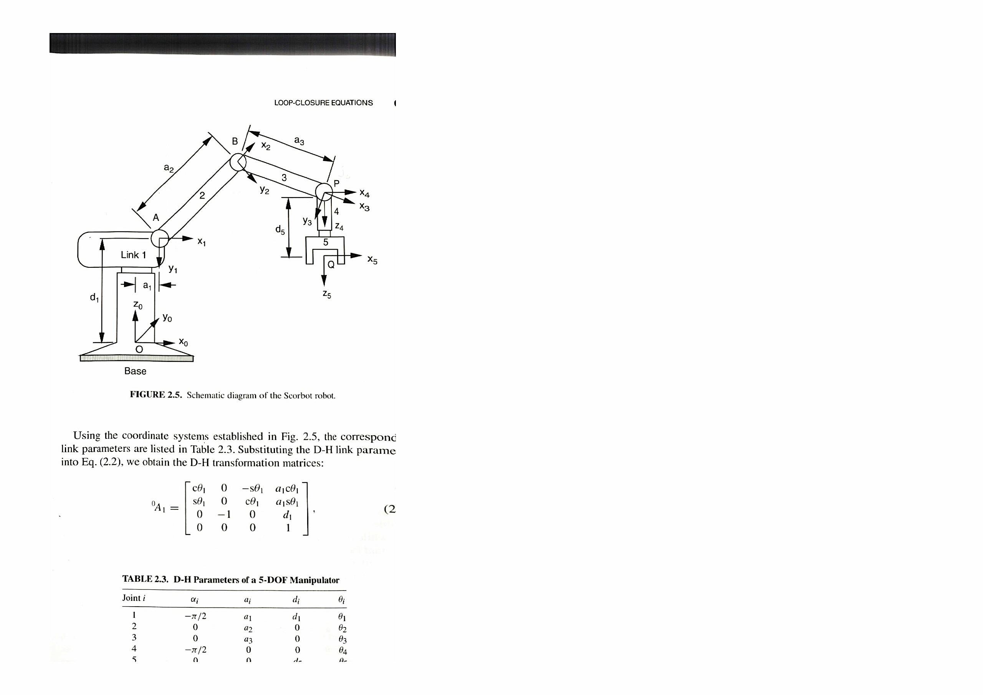
30
7. Scorbot Robot Kinematics
Fig. 7 shows a schematic diagram of the Scorbot robot.
Fig.7
In this diagram, the second, third and fourth joint axes are parallel to one another and point into the paper at points A,B and P, respectively.
The first joint axis point up vertically, and the fifth joint axis intersects the fourth perpendicular. We wish to find the overall transformation matrix for the robot.

Slide 146
31
Using the coordinate system established in Fig.7, the corresponding link paramateres are listed in Table 3.
Table 3. D-H Parameters for a Scorbot Robot
Substituting the D-H link parameters into Eq.6, we obtain the D-H transformation matrices:
(19)

Slide 147
32
(20)
(21)
(22)

Slide 148
33
(23)
Multiplying Eq5. (20), (21) and (22) yields
(24)
where

Slide 149
34
Note that Eq.(24) provides a transformation from the fourth coordinate system to the first coordinate system.
We may treat and as new variables In this way, the orientation sub matrix contains only one variables while the position submatrix contains two variables and
This important fact can be used for deriving a closed form solution for any manipulator with three consecutive parallel joint axes.
Multiplying Eq5. (19), (24) and (23) yields the elements of the transformation matrix
(25)

Slide 150
35
(26)
(27)
(28)
Since this is a 5-DOF manipulator, only five of the six parameters of the end-effector can be specified. Very often, the desired position of a point and the direction of a line in the end-effector (e.g., the position of point Q and the direction of x₅-axis) are specified.
5-DOF manipulators are useful for spray painting, spot welding and sealant applications for which only the position and direction of a line are essential.

Slide 151
36
8. Other Coordinate Systems
In the preceding lecture, the z_{o} –axis of the base coordinate system was chosen to be in link with the first joint axis, and the z_{n}-axis of the hand coordinate system was chosen to be in the direction of approach.
If an additional coordinate system is defined in the base with a transformation matrix and another coordinate system is defined in the
tool frame with a transformation matrix the loop-closure equation (18) can be modified as
(29)
where and are constant transformation matrices.

Slide 152
37
9. Position analysis of the Scorbot Robot
For the Scorbot robot shown in Fig.8 the loop- closure equation is given by
(30)
Fig. 8

Slide 153
38
where the transformation matrices and are given by
(31)
(32)

Slide 154
39
(33)
(34)
(35)

Slide 155
40
Multiplying Eq5 (31), (32), (33), (34) and (35) yields the elements of the transformation matrix :
(36)
where
(37)
(38)

Slide 156
41
(39)
(40)
9.1. Direct Kinematics
For the direct kinematics problem, we simply substitute the given joint angles into Eg5 (37), (38), (39) and (40) to obtain the end - effector position
orientation in terms of the three unit vectors
and

Slide 157
42
9.2 Inverse Kinematics
For the inverse kinematics problem only 5 of the 12 parameters associated with the end-effector position vector and rotation matrix can be specified at will. This is because the manipulator has only 5 DOF. Multiplying both sides of the loop closure equation (30) by we obtain
(41)
Equating the first column of Eq.(41), we obtain
(42)
(43)
(44)

Slide 158
43
Similarly, equating the fourth column of Eq. (41), we obtain
(45)
(46)
(47)
The firs joint angle is obtained immediately from Eq. 47:
(48)
The fifth joint angle is obtained from Eq. 44:
(49)
Eqs. (42) and (43) produce a unique solution :
(50)

Slide 159
44
Next, we solve Eqs. (45) and (46) for and
Eqs. (45) and (46) can be written
(51)
(52)
where
(53)
(54)
Summing the squares of Eqs. (51) and (52) yields
(55)
Hence
(56)

Slide 160
45
Once is known , we can solve by expanding Eqs. (51) and (52) as follows:
(57)
(58)
Solving Eqs. (57) and (58) for and yields
(59)
(60)
Hence
(61)
Finally, is obtained by
(62)

Slide 161
Lecture 12-13. POSITION ANALYSIS OF THE FANUC ROBOT
Topics:
1
1. Direct Kinematics
2. Inverse Kinematics
3. Wrist Center Position
4. End-Effector Orientation

Slide 162
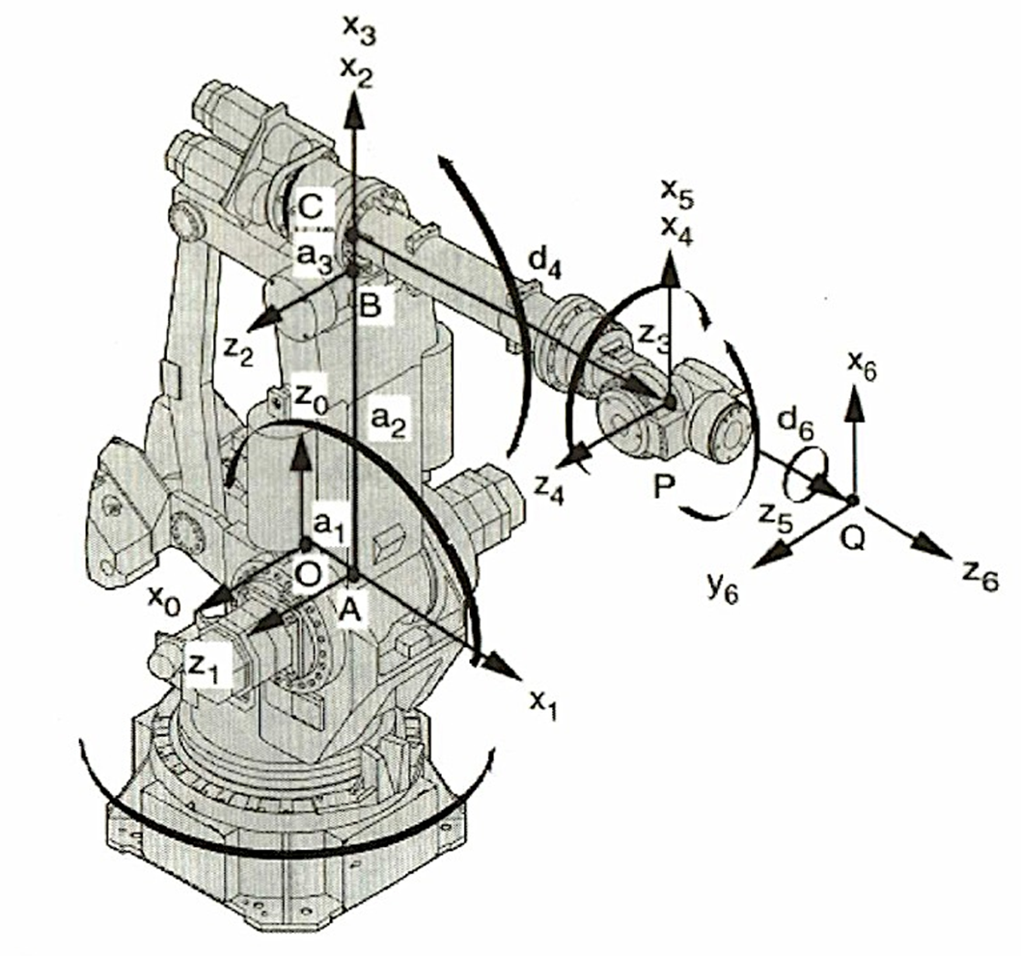
1. Direct Kinematics
2
Fig.1 shows a 6-DOF Fanuc robot.
Fig.1

Slide 163
3
In the manipulator of this robot the first joint axis points up vertically along the
–axis, the second joint axis is perpendicular to the first joint axis with a small offset distance =OA, the third joint axis is parallel to the second with an offset distance = AB, and the fourth joint axis is perpendicular to the third joint axis with a small offset distance = BC.
In addition, the last three joint axes intersect one another perpendicularly in sequence at a common point P.

Slide 164
4
This robot belongs to a special class of manipulators where the last three joint axes intersect at the wrist center.
The kinematics problem for this type of manipulators can be partitioned into two sub- chains: one associated with the first three links and other with the last three moving links.
That is, in solving the inverse kinematics problem, the position of the wrist center can be solved independently of the orientation part, therefore reducing the complexity of the problem.
We note that this manipulator employs a four- bar linkage to drive the third joint. Otherwise, it has no effect on the kinematics of the manipulator.
In the following analysis we neglect the effect of the four- bar linkage and treat the manipulator as four- bar linkage and treat the manipulator as a serial manipulator.

Slide 165
5
Using the coordinate systems established in Fig.1, the corresponding link parameters are listed in Table 1.
Fig.1

Slide 166
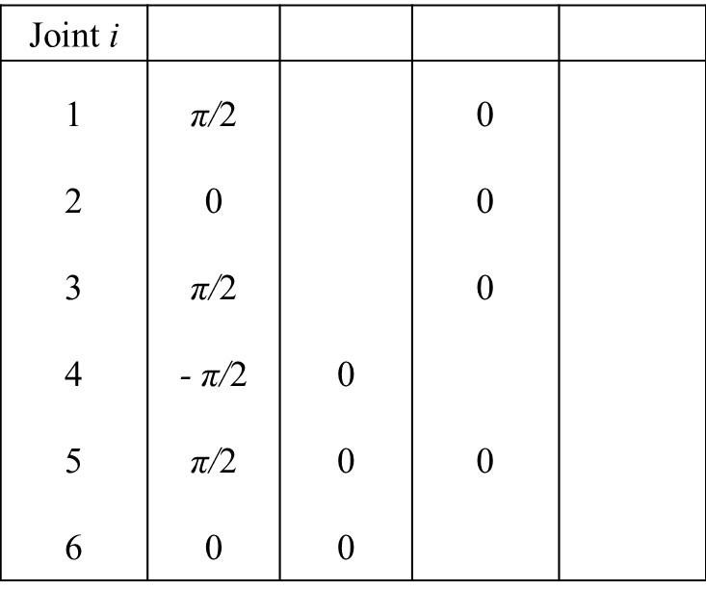
6
Table 1. D-H Parameters of the Fanuc Manipulator

Slide 167
5
Substituting the D-H parameters into the transformation matrix
,
, (1)
we obtain the D-H transformation matrices:
, (2)

Slide 168
6
, (3)
, (4)
, (5)

Slide 169
7
, (6)
. (7)
The end-effector location is given by
, (8)

Slide 170
8
The loop-closure equation is obtained in two steps.
First, we multiply Eqs. (2), (3) and (4):
. (9)
Next, we multiply Eqs.(5), (6) and (7) :
. (10)

Slide 171
9
Hence the resulting transformation matrix is given by
(11)
where describes the end-effector location
Substituting Eqs.(9) and (10) into (11) yields the elements of as follows
(12)
(13)

Slide 172
10
(14)
(15)
Although the equations above can be used to solve the inverse kinematics, they are highly nonlinear and difficult to solve. In what follows we present a more efficient method of solution by separating the wrist-center-position problem from the orientation problem.

Slide 173
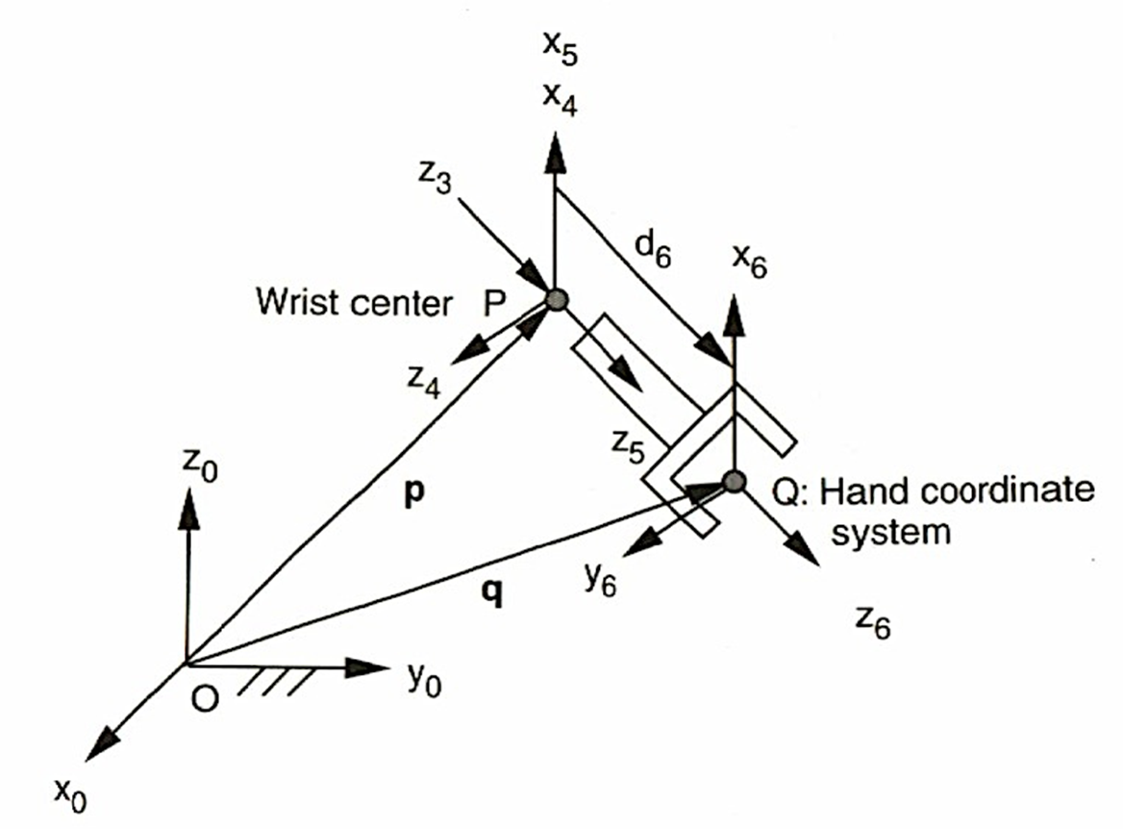
3. Wrist Center Position
Note that the last three joint axes intersect at the wrist center point P as shown in Fig. 1. Hence rotations of the last three joints do not affect the position of the point P.
Fig. 2 shows the end-effector coordinate system , the wrist center P and the vector relation between them
Fig. 2
11

Slide 174
12
The wrist center position with respect to and expressed in the base coordinate system Is
(16)
Hence, given the end-effector location, we can find the position of wrist center point with respect to the base coordinate system.

Slide 175



13
Furthermore, we observe from Fig. 1 that the position of the wrist center with respect to the link 3 coordinate system is given by
.
Transforming into the base coordinate system we obtain
.
Eq. (18) consists of three scalar equations in three unknowns. Hence, the position and orientation of the inverse kinematics problem are decoupled. Theoretically, we can solve Eq. (18) for the three joint angles.
Multiplying both sides Eq. (18) by the inverse of , we obtain
(19)
Substituting Eqs. (2) through (4) into (19) yields
(20)
,
(21)
,
(22)
.Where , , and are given by Eq. (16)

Slide 176

14
A solution for is found immediately by solving Eq. (22)
. (23)
Hence there are two solution of . Specifically, if Is a solution,
is also a solution, where .
We call the front-reach solution and the back-reach solution.
Summing the squares of Eqs. (20), (21) and (22) gives
, (24)
where

Slide 177




15
We can convert Eq. (24) into a polynomial by making use the following trigonometric identities:
, (25)
, (26)
where
.
, (27)
Substituting the trigonometric identities above into Eq. (24) yields
(28)
Hence
, . (29)

Slide 178
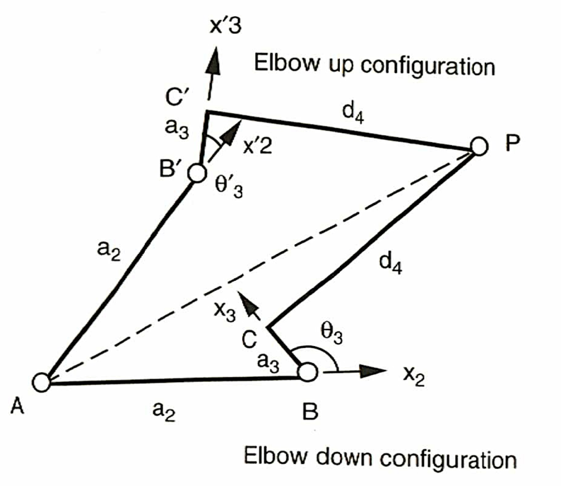
Eq. (28) yields two real roots if , one double root if
and no real roots if .
When Eq. (28) yields a double root, the arm is either in a fully stretched or a folded- back configuration. On the other hand, if Eq. (28) yields no real roots, the position is not reachable.
Fig. 3 shows two different arm configurations, corresponding to the two solutions of .
Fig. 3
16

Slide 179
17
Once and are known, can be obtained by back substitution. Expanding Eqs. (20) and
(21), we obtain
, (30)
, (31)
where
,
,
,
,
,
.
Therefore, we can solve Eqs. (30) and (31) for and . Once and are found, a unique value of is obtained by taking
(32)

Slide 180





18
3. End-Effector Orientation
Once , and are solved, is completely known.
The remaining joint angles can be found by multiplying both sides of Eq. (11) by
:
. (33)
We note that the elements on the right-hand side of Eq. (33) are known, and only the rotation part of Eq. (33) is needed for computation of the last three joint angles.
The rotation matrices and are given by the upper 3x3 submatrices of Eqs. (9) and (10), respectively.

Slide 181
19
Equating the 3x3 element of Eq. (33) yields
, (34)
where .
Hence, corresponding to each solution set of , and , Eq. (34) yields two real
roots if and or if .
When or , the sixth joint axis, , is in line with the fourth joint axis, , and the wrist is said to be in a singular configuration.
The condition cannot physically arise.

Slide 182

20
Assuming that , we can solve and as follows.
Equating the 1x3 element of Eq. (33) yields
(35)
Equating the 2x3 element of Eq. (33) yields
(36)
Hence, corresponding to each solution set of , , and , Eqs. (35) and (36) yield a unique solution of :
(34)

Slide 183


21
Similarly, equating the 3x1 element of Eq. (33) yields
(38)
Equating the 3x2 element of Eq. (33) yields
(39)
Hence, corresponding to each solution set of , , , and , Eqs. (38) and (39) yield a unique solution of :
(40)
We conclude that corresponding to each solution set of the first three joint angles, there are two possible wrist configurations.
Since there are four possible upper arm configurations, a total of eight manipulator postures are possible.
However, due to mechanical limits, fewer than eight manipulator postures are physically realizable.
When , Eqs. (35) through (40) generate. For such a singular
configuration, only the sum or difference of and can be computed.

Slide 184
Лекции 14-15
Динамический анализ параллельных роботов
Обобщенные матрицы преобразования.
Матрицы бинарных звеньев и кинематических пар.
Матричные уравнения замкнутости контуров.
Анализ перемещений.
Аналоги скоростей и ускорений звеньев.
Кинетическая и потенциальная энергии.
Дифференциальные уравнения движения.
1

Slide 185
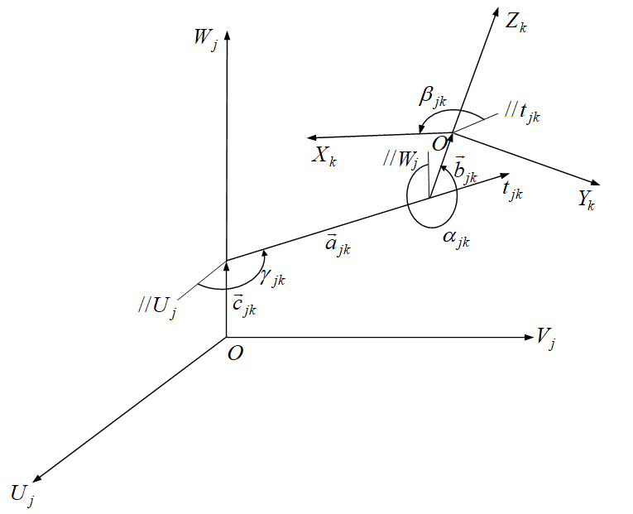
Обобщенные матрицы преобразования
Рис.1
2

Slide 186
3

Slide 187
(1)
(2)
4

Slide 188
где
(3)
(4)
5

Slide 189
(5)
(6)
6

Slide 190
(7)
(8)
7

Slide 191
(9)
8

Slide 192
(10)
(11)
9

Slide 193
(12)
10

Slide 194
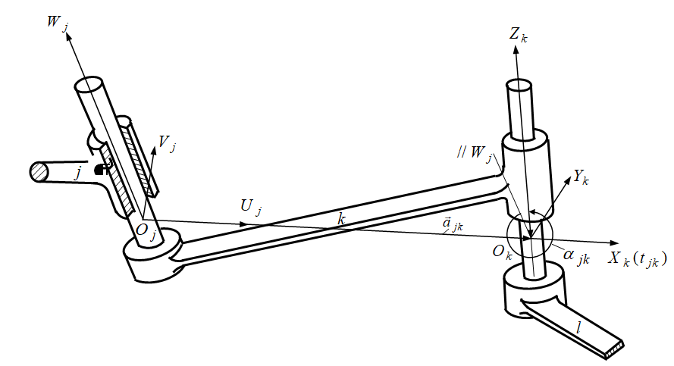
2. Матрицы бинарных звеньев
2.1. Бинарная звено вида ЦЦ
Рис.2
11

Slide 195
(13)
12

Slide 196
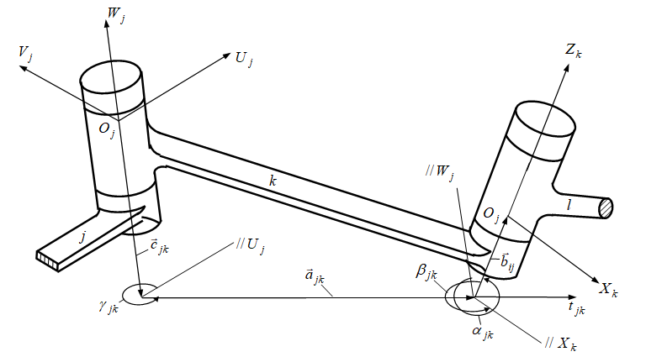
2.2. Бинарное звено вида BB
Рис.3
13

Slide 197
(14)
14

Slide 198
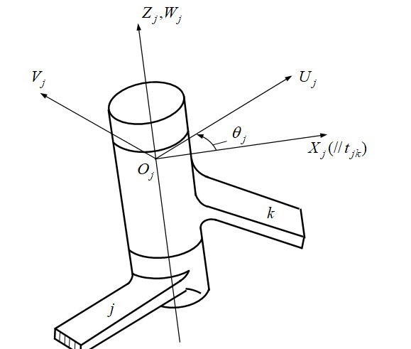
3. Матрицы кинематических пар
3.1. Вращательная кинематическая пара
Рис.4
15

Slide 199
(15)
16

Slide 200
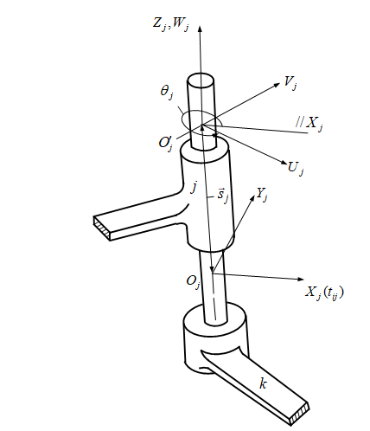
3.2. Цилиндрическая кинематическая пара
Рис.5
17

Slide 201
(16)
18

Slide 202
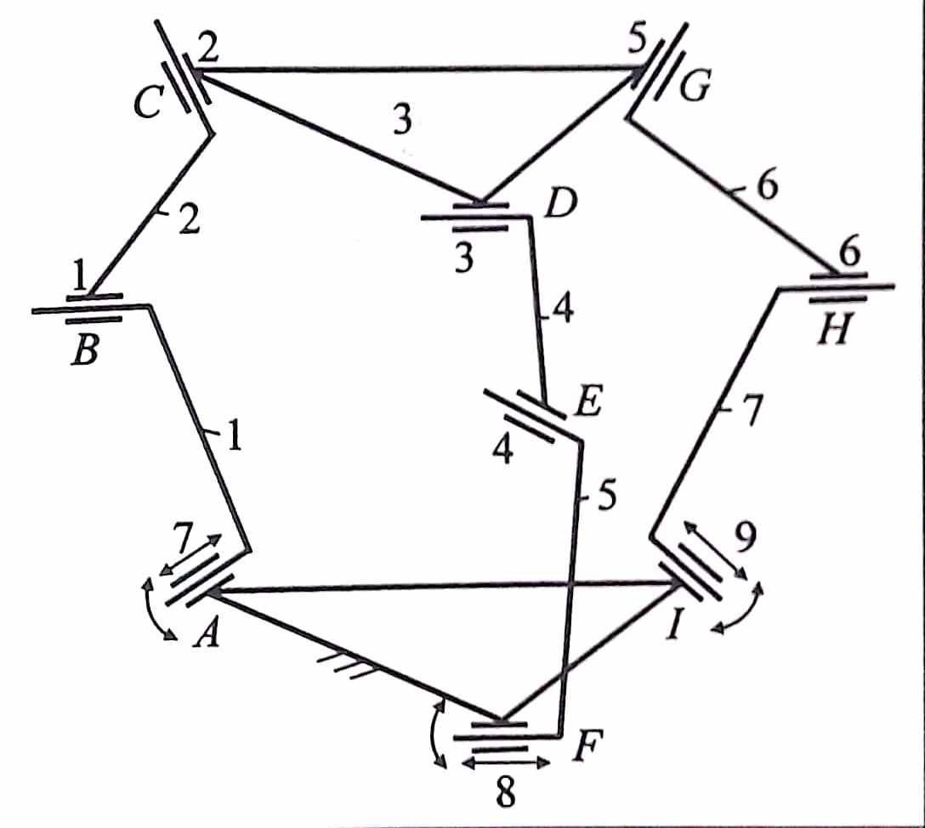
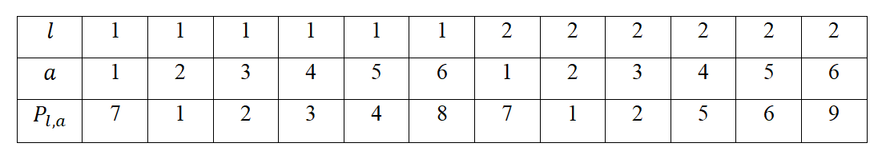
Пример
Рис.6
Таблица 1.
19

Slide 203
Символические уравнения замкнутости контуров:
(17)
20

Slide 204
(18)
21

Slide 205
5. Анализ перемещений
(21)
(22)
22

Slide 206
(24)
(25)
23

Slide 207
(23)
24

Slide 208
(24)
(25)
25

Slide 209
(26)
(27)
(28)
26

Slide 210
(31)
(32)
(33)
(34)
27

Slide 211
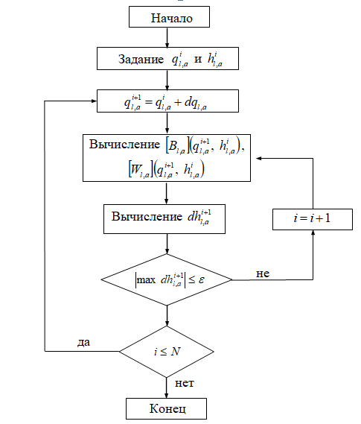
Рис.7
28

Slide 212
- 29 -
Свяжем со стойкой абсолютную систему координат . Тогда координаты точки на любом подвижном звене определяются уравнением
. (33)
Здесь матрица с постоянными параметрами представляет собой матрицу перехода с системы координат к системе координат и определяется уравнением (34)
Если ввести обозначение
(35)
то уравнение (33) принимает вид
(36)

Slide 213
- 30 -
6. Аналоги скоростей и ускорений звеньев
Аналогами скоростей и ускорений звена по обобщенным координатам и называются соответственно первая и вторая частные производные от зависимых переменных по обобщенным координатам и
(37)
(38)
(39)

Slide 214
- 31 -
Для определения аналогов скоростей звеньев дифференцируем матричные уравнения замкнутости контуров (19) по обобщенной координате
(40)
и получаем матричные уравнения вида
(41)
где (42)
Введем обозначение
(43)
Тогда уравнения (41) принимают вид
(44)

Slide 215
-32-
(45)
Элементы матрицы имеют вид
(46)
Из уравнения (46) видно, что матрица имеет шесть независимых элементов, которые расположены ниже главной диагонали. Матричные уравнения (19) хотя эквивалентны скалярным уравнением, из них уравнений являются независимыми, которые состоят из элементов матриц , расположенных ниже главной диагонали. Полученная система уравнений является линейной относительно аналогов скоростей зависимых
переменных , откуда определяются их значения.

Slide 216
-33-
Аналоги ускорений звеньев определяются дифференцированием уравнений (44) по обобщенной координате
(47)
где
(48)
Здесь
(49)
Тогда уравнения (47) принимают вид
(50)
которые решаются относительно аналогов ускорений зависимых переменных аналогично решению уравнений (44).

Slide 217
-34-
Производные по времени от обобщенных координат представляют собой обобщенные скорости
(51)
Производные по времени от остальных зависимых переменных параметров могут быть выражены через обобщенные скорости по формуле
(52)
Дважды дифференцируя обобщенные координаты по времени получаем обобщенные ускорения
(53)

Slide 218
-35-
Вторые производные по времени от зависимых переменных
определяются по формуле
(54)
Скорость точки движущегося звена получается путем дифференцирования по времени уравнения положения точки (35), учитывая, что матрица и радиус-вектор являются постоянными
(55)
где
(56)

Slide 219
-36-
Зная скорость движущегося звена, найдем кинетическую энергию данного звена. Обозначим через кинетическую энергию звена . Пусть обозначает кинетическую энергию
элемента массы звена . Тогда
(57)
где - след матрицы, т.е. сумма диагональных элементов матрицы, который в дальнейшем позволяет перейти к матрице инерции звена .
Подставляя в выражение (57) значения из равенства (55), получим
. (58)

Slide 220
-37-
Здесь матрица не зависит от распределения массы звена
. Не зависит от распределения массы также и обобщенные скорости и . Тогда, интегрируя уравнение (58), получим кинетическую энергию звена
(59)
где интегральный член в скобках представляет собой матрицу
инерции звена
(60)

Slide 221
-38-
Если известны масса , координаты центра масс
звена в системе, связанной с звеном , осевые и центробежные моменты инерции звена
в той же системе координат, то матрицу инерции данного звена можно записать в виде
(61)
Суммируя кинетические энергии всех звеньев, получаем кинетическую энергию ПР
(62)

Slide 222
-39-
Для вычисления потенциальной энергии силы тяжести звеньев введем вектор , элементами которого служат составляющие ускорения силы тяжести по осям абсолютной системы координат
,
(63)
Определим координаты центра масс каждого звена. Они заданы в собственной системе координат звена и входят а первую строку или
столбец матрицы инерции . Поэтому, вводя единичный вектор
определим вектор положения центра масс звена в виде
(64)

Slide 223
-40-
Положения центров масс звена в абсолютной системе координат определяются уравнениями
(65)
Потенциальная энергия силы тяжести каждого подвижного звена
может быть вычислена как работа по его перемещению из начала абсолютной системы координат в его фактическое положение. Суммируя по всем подвижным звеньям, находим
. (66)

Slide 224
-41-
7. Дифференциальные уравнения движения
(69)
где -функция Лагранжа
(70)
-обобщенная сила, соответствующая обобщенной координате
, которая включает в себя как приложенную внешнюю, так и диссипативную силы, которая находится из принципа виртуальных перемещений.
На основании уравнения (70) получаем функцию Лагранжа в виде
(69)

Slide 225
-42-
При вычислении производных, входящих в уравнения Лагранжа, следует иметь в виду, что матрицы составляющих скорости , матрицы преобразования координат и зависимые переменные
являются неявными функциями обобщенных координат. В то же время величины , и не зависят от обобщенных
скоростей . Матрицы инерции , матрица положения
стойки , вектор ускорения силы тяжести и единичный вектор - постоянные величины.
С учетом этих замечаний вычислим обобщенные импульсы, дифференцируя функцию Лагранжа (4.22) по обобщенным скоростям
(72)

Slide 226
-43-
Заменяя индекс на и объединяя обе суммы под общей группой символов суммирования, получаем
(73)
Так как следы матрицы и транспонированной матрицы совпадают, то можно написать
(74)
Поскольку матрица симметрична, а сумма следов двух матриц равняется следу их суммы, то получим
(75)

Slide 227
-44-
После подстановки выражения импульса функции Лагранжа из (75) в уравнение Лагранжа (69) и дифференцирования по времени и обобщенной координате получим уравнения движения ПР в виде
.
(76)
Обобщенные силы в уравнениях (4.27), учитывающие приложенные внешние силы и диссипативные силы, определяются через виртуальную работу , совершаемую над системой на произвольном виртуальном перемещении ,
(77)

Slide 228
-46-
Пусть в кинематической паре действует сила сопротивления, пропорциональная скорости. Тогда сила демпфирования определяется выражением
(78)
где - коэффициент демпфирования, который задается или определяется экспериментально.
Присоединяя в уравнение (78) заданные внешние силы , в кинематических парах получаем полную силу
(79)
Сила считается положительной, если производит над системой положительную работу на положительном виртуальном перемещении . Силы, приложенные в других точках звеньев, могут быть приведены к эквивалентным силам и моментам, приложенным в кинематических парах.

Slide 229
-47-
Малые виртуальные приращения обобщенных координат вызывают малые виртуальные смещения в каждой кинематической паре
Совершаемая виртуальная работа равна произведению силы (77) на перемещения (78), вдоль которого она действует,
Суммируя равенство (79) по всем кинематическим парам, получим
(78)
(79)
(80)

Slide 230
-48-
Тогда с учетом равенства (80) уравнения движения ПР имеют вид
(81)

Slide 231
-49-
Уравнения движения (81) представляют собой систему связанных нелинейных дифференциальных уравнений второго порядка, приводимую к следующему общему виду
(82)
где
(83)
(84)
(85)
(86)

Slide 232
-50-
Коэффициенты и в уравнении (82) называются динамическими коэффициентами, где коэффициенты устанавливают связь действующих в кинематических парах сил и
моментов с обобщенными ускорениями, коэффициенты устанавливают связь действующих в кинематических парах сил и моментов с обобщенными скоростями, коэффициенты учитывают потенциальные энергии пружин и звеньев.
Уравнения (84) могут быть использованы для решения прямой и обратной задачи динамики ПР. Прямая задача динамики ПР состоит в том, чтобы по заданным силам и моментам определить обобщенные ускорения, интегрирование которых позволяет определить значения обобщенных координат и скоростей. В обратной задаче динамики ПР по заданным обобщенным координатам, скоростям и ускорениям определяются силы и моменты, действующие в приводах.

